Slide 1
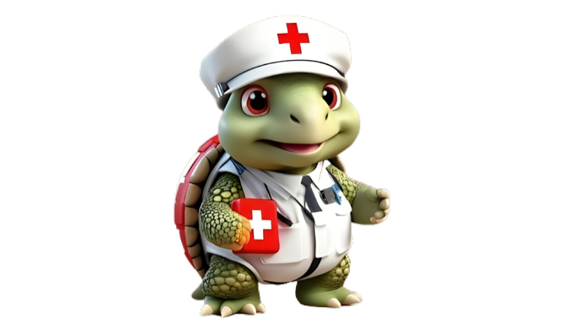

Environmental Emergencies
DEFINITION, IDENTIFICATION, CAUSES, SYMPTOMS, AND TREATMENT GUIDE

Slide 2
f. Poisoning

Slide 3
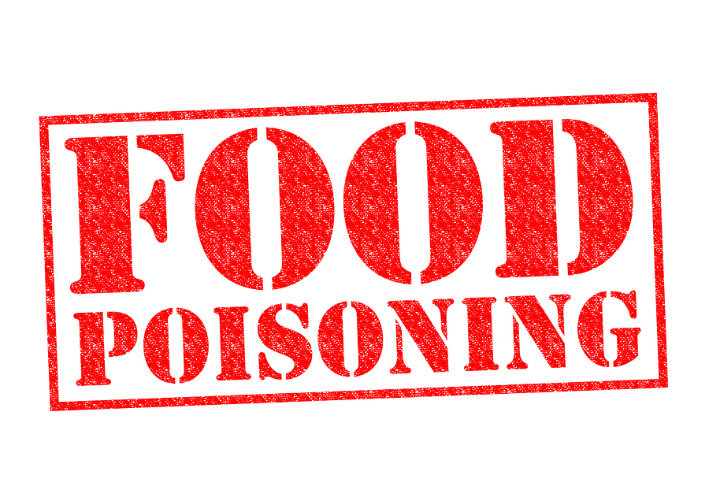

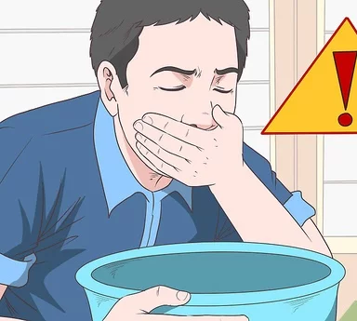
What is Poisoning ?
Poisoning is caused by exposure to a harmful substance. This can be due to swallowing, injecting, breathing in, or other means. Most poisonings occur by accident.

Slide 4
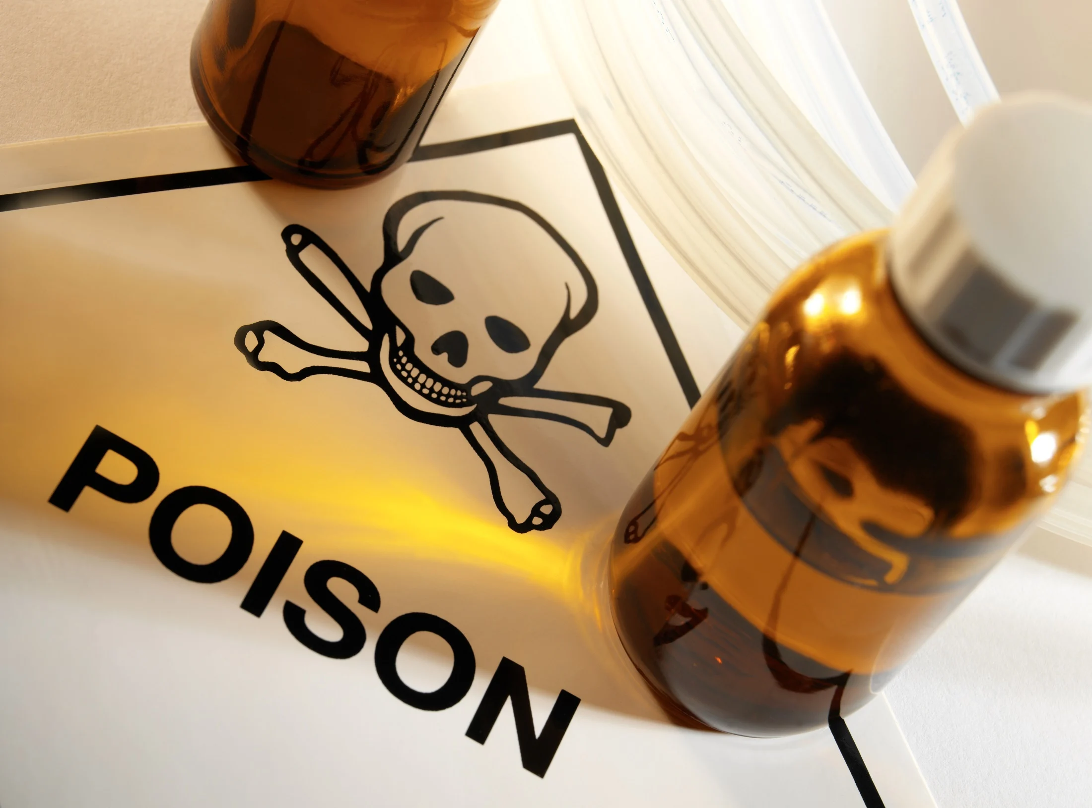

How to identify if someone is poisoned ?
Indicator 1
Unexpected and unexplained symptoms such as nausea, vomiting, dizziness, difficulty breathing, or seizures.
Indicator 2
Finding open or empty containers of potentially harmful substances and any substances without proper labelling or in unmarked containers

Slide 5
Symptoms of Poisoning

Slide 6
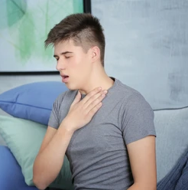
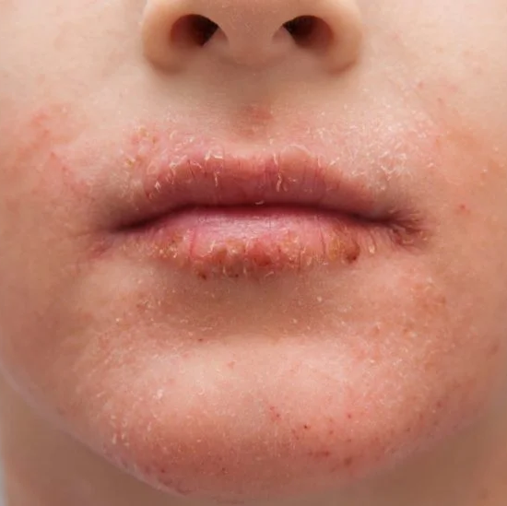
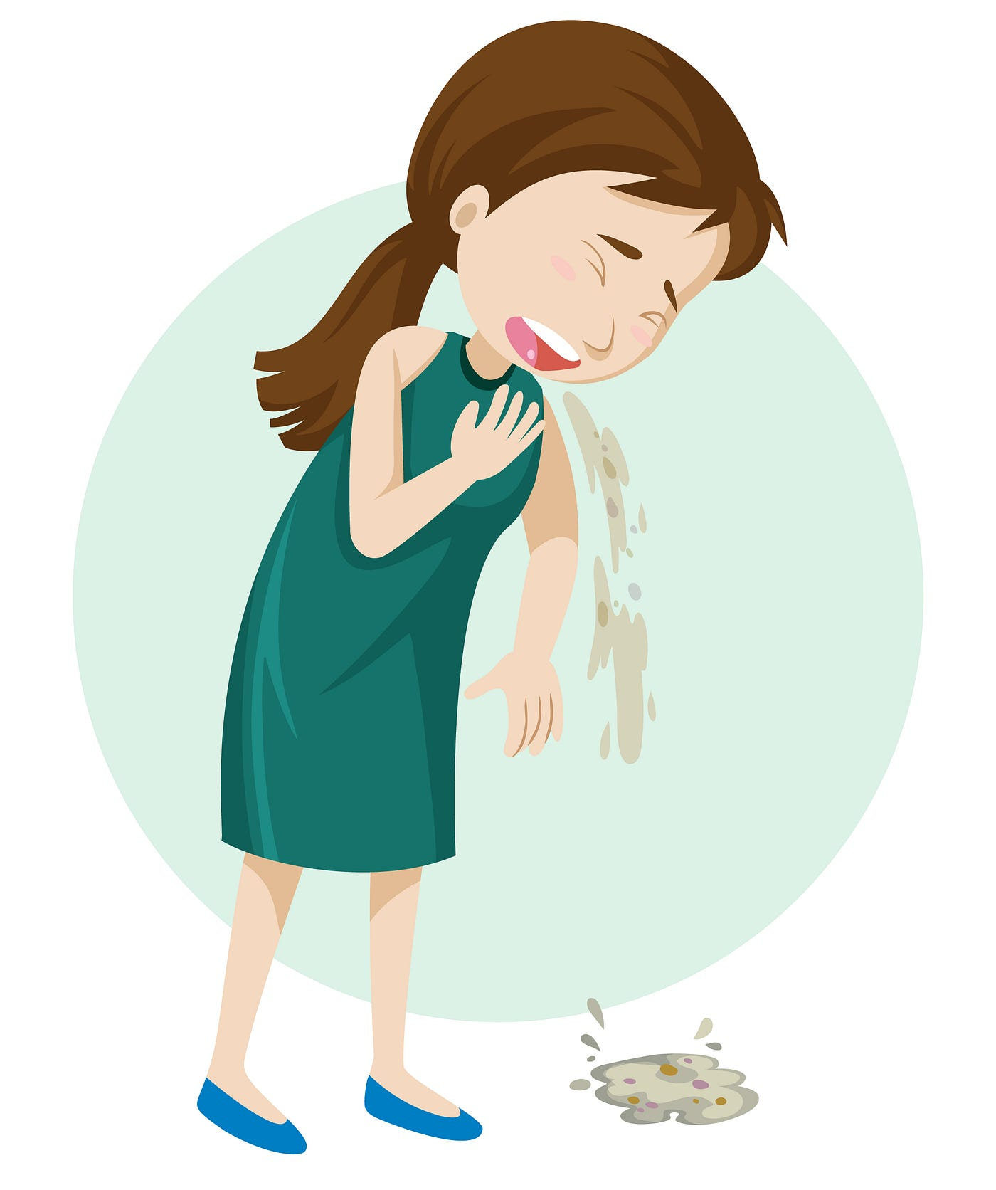
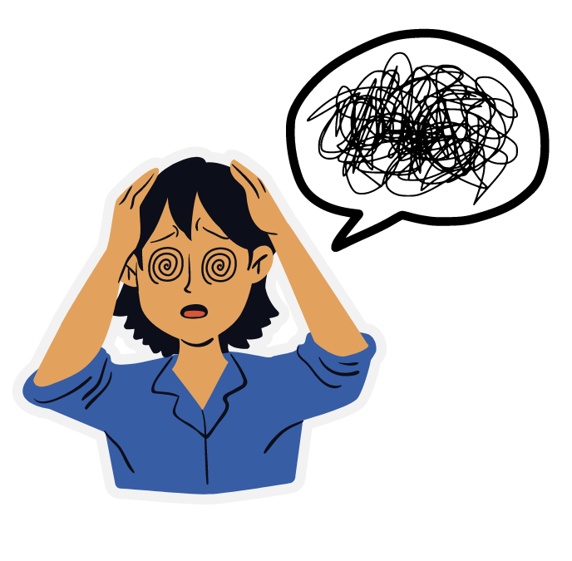
02.
04.
Burns or redness around the lips and breath smelling like chemicals, gasoline, paint thinner
Difficulty breathing, shortness of breath
01.
Nausea, vomiting, dizziness
03.
Confused, Altered mental state or Unconsciousness

Slide 7
What to do ?

Slide 8
In case of Suspected Poisoning,
- Do not treat the person yourself
- Contact your local poison control centre.
Do not wait for the victim to look or feel sick.
First aid guide:
Call for help: Seek emergency medical help immediately, until they arrive
Remove from exposure:
- Swallowed poison: Remove anything remaining in the person's mouth.
- Poison on the skin: Remove any contaminated clothing using gloves. Rinse the skin in a shower or with a hose.
- Poison in the eye: Gently flush the eye with cool or lukewarm water.
- Inhaled poison: Get the person into fresh air as soon as possible.
DO NOT give the person anything to eat or drink unless directed to do so.
DO NOT induce vomit: Keep the affected person calm and do not induce vomiting unless told to do so by the medical professional, as it may worsen the situation sometimes.
Administer CPR: If the person is unconscious and not breathing, start CPR.
Provide information: Share information about the suspected poison, the amount, and the person's symptoms with emergency services.

Slide 9
ASSESSMENT
Which of the following symptoms may indicate someone has been poisoned?
  Sudden and severe vomiting
  Difficulty breathing or dizziness
  Confusion or unusual drowsiness
  Seizures or convulsions
  All of the above
If you suspect someone has been poisoned, what is the FIRST thing you should do?
  Administer medication or home remedies.
  Contact emergency services immediately.
  Try to identify the poison.
  Force the person to vomit.
  Wait for person to show symptoms
Answer: 1) All of the above 2) b, c

Slide 10
IMPORTANT INFORMATION
What is the National Poison Control Center number in India?
1800-425-1213
THEY ANSWER CALLS ANYWHERE FROM INDIA
AVAILABLE 24/7
365 DAYS

Slide 11
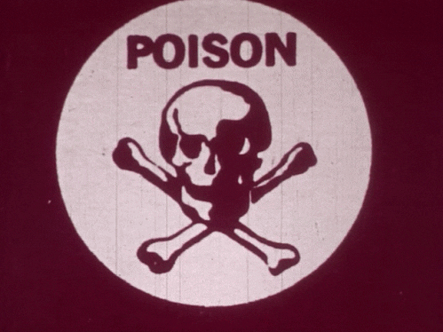
REFRESHER
Poisoning is a serious health issue resulting from exposure to harmful substances, often accidental.
Symptoms include nausea, vomiting, dizziness, difficulty breathing, and seizures. It is crucial to report any open or empty containers of potentially harmful substances and any substances without proper labeling or in unmarked containers.
In case of suspected poisoning, do not treat the person yourself and contact a local poison control center.
First aid involves calling for help, removing contaminated clothing, flushing the eye with cool or lukewarm water, and bringing the person into fresh air.
Do not give the person anything to eat or drink unless directed, and do not induce vomiting unless instructed by a medical professional.
If the person is unconscious and not breathing, start CPR.
Share information about the suspected poison, the amount, and the person's symptoms with emergency services

Slide 12
Thank you for your attention, It may save a life one day
FOR MORE INFORMATION CONTACT +91 9911772407 OR EMAIL AT INFO@INFINITI8.ORG

