Slide 1
Environmental Emergencies
DEFINITION, IDENTIFICATION, CAUSES, SYMPTOMS, AND TREATMENT GUIDE

Slide 2
h. Laboratory Injury

Slide 3
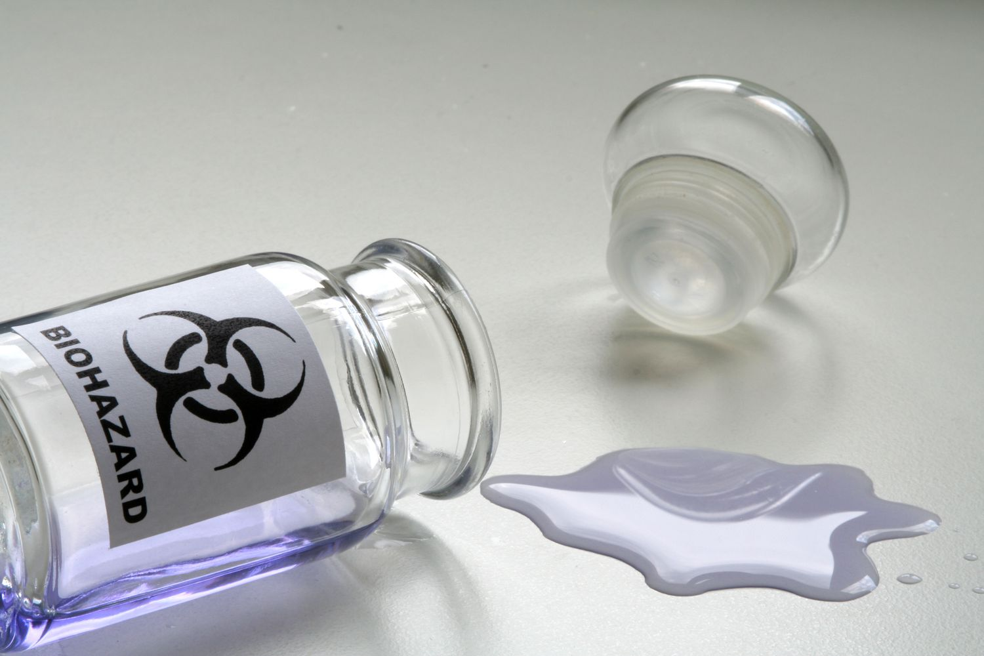
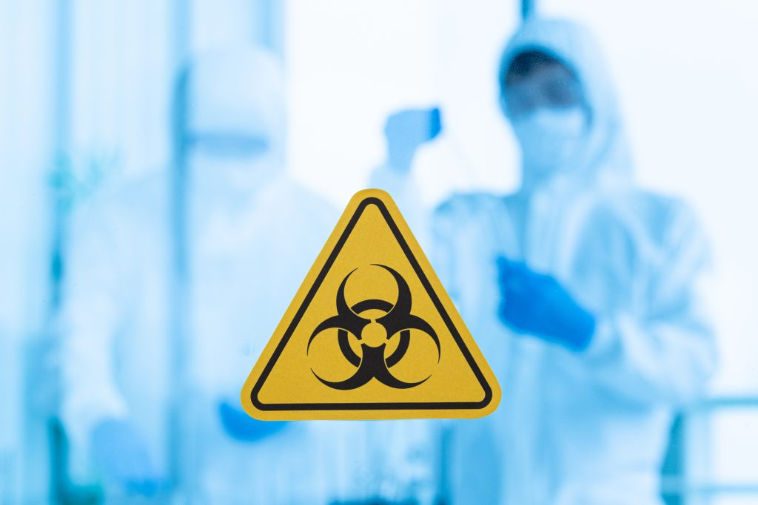
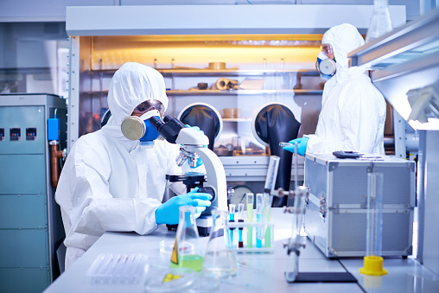
What is Laboratory Injury ?
Laboratory injuries refer to accidents or harm that occur in a laboratory setting, where individuals are exposed to various hazards and substances. These injuries can result from chemical exposure, fires, explosions, electrical incidents, cuts, burns, or other accidents that may happen during experiments or work in a laboratory.

Slide 4
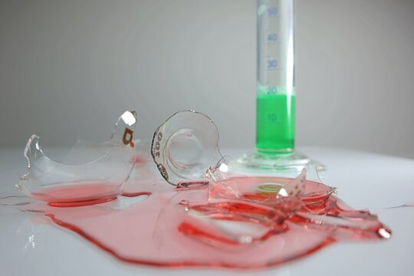
Identification of Laboratory Injury Identifying laboratory injuries involves recognizing signs and situations that indicate potential harm or accidents, including:
Spills or Leaks
Presence of spilled chemicals or substances. Detection of unusual smells, may indicate the release of harmful gases or chemicals.
Burn marks
Evidence of burns on equipment, surfaces, or individuals.
Smoke or fire
Indicators of a fire or potential electrical issues.
Injuries or distress
Observing individuals with cuts, burns, or other signs of injury.
Malfunctioning equipment
Equipment that is not working correctly or shows signs of damage.

Slide 5
Causes of Laboratory Injury

Slide 6
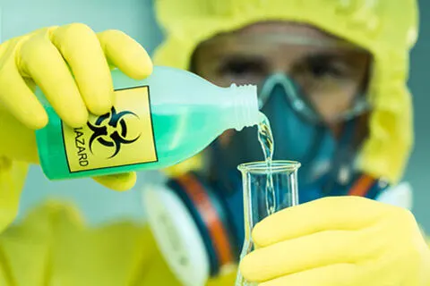
Causes of Laboratory Injury Laboratory injuries can be caused by a variety of factors, including:
Chemical / Biological exposure
Contact with hazardous chemicals or improper handling. Exposure to infectious materials or microorganisms.
Fire and explosion
Flammable materials, electrical issues, or equipment malfunctions.
Cuts and abrasions
Mishandling of sharp objects or broken glass.
Electrical incidents
Contact with live electrical components.
Equipment failure
Malfunctioning laboratory equipment or instruments.

Slide 7
Symptoms of Laboratory Injury

Slide 8
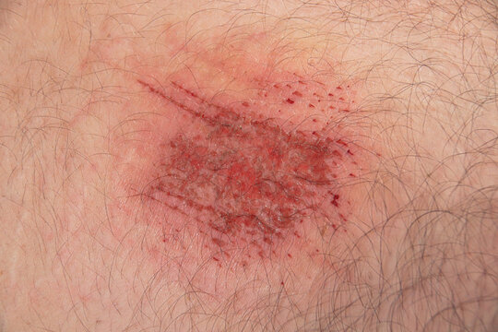
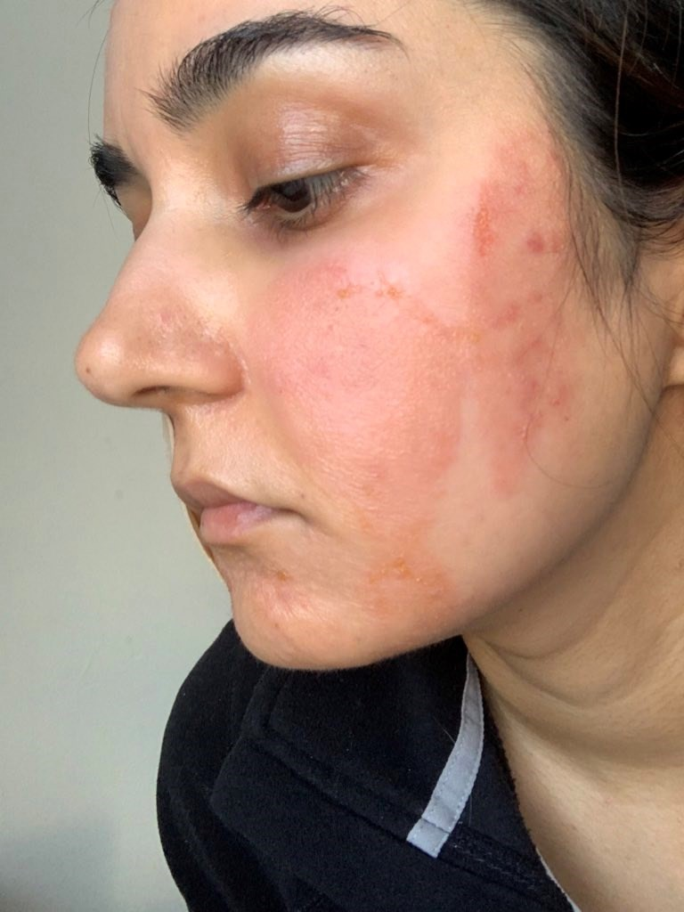
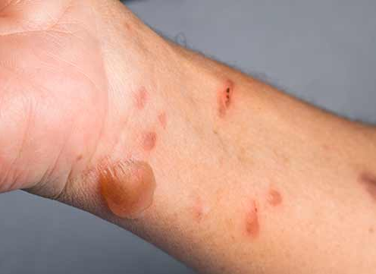
02.
04.
Dizziness or loss of consciousness
Cuts, abrasions or puncture wounds
03.
Burns from fire or hot surfaces
01.
Chemical burns, skin, eye irritation & Injuries

Slide 9
What to do?

Slide 10
FIRST AID GUIDE
Assess the situation: Ensure your safety and the safety of others before providing assistance.
Call for help: Call for emergency services and provide information about the situation. Until the help arrives,
Evacuate if necessary: If there's a fire, explosion, or any immediate danger, evacuate the area following established safety procedures.
Chemical exposure: Rinse the affected areas with water for at least 15 minutes. Remove any contaminated clothing.
Cuts and abrasions: Clean the wound with mild soap and water. Apply sterile bandages.
Burns: Cool burns with cold running water for at least 10 minutes. Do not use ice. Seek medical attention as soon as possible.
Eye injuries: Flush the eyes with water for at least 15 minutes. Seek medical attention promptly.
Electrical shock: Do not touch the person until the power is turned off. Perform CPR if necessary.

Slide 11
ASSESSMENT
You accidentally splash a small amount of concentrated acid on your hand in the lab. Your first step should be:
Apply cold water to the area immediately.
Neutralize the acid with a base like baking soda.
Call for help and follow emergency procedures.
Try to flush the acid away with tap water.
While working with open flames in the lab, your hair catches fire. What should you NOT do?
Stop, drop, and roll.
Pat the flames out with your bare hands.
Cover your face and head with a fire blanket.
Run outside for help.
Answer: 1) c 2) b

Slide 12
REFRESHER
Laboratory injuries are accidents or harm that occur in a laboratory setting, resulting from various hazards and substances.
These injuries can occur from chemical exposure, fires, explosions, electrical incidents, cuts, burns, or other accidents during experiments or work.
Symptoms include chemical burns, skin, eye irritation, injuries, cuts, abrasions, burns from fire or hot surfaces, dizziness or loss of consciousness.
First Aid for laboratory injuries involves assessing the situation, calling for help, evacuation if necessary, rinsing affected areas with water, cleaning wounds with mild soap and water, cooling burns with cold running water, flushing eyes with water, and performing CPR if necessary.
It is crucial to ensure the safety of others and call emergency services.

Slide 13
Thank you for your attention, It may save a life one day
FOR MORE INFORMATION CONTACT +91 9911772407 OR EMAIL AT INFO@INFINITI8.ORG

