Slide 1
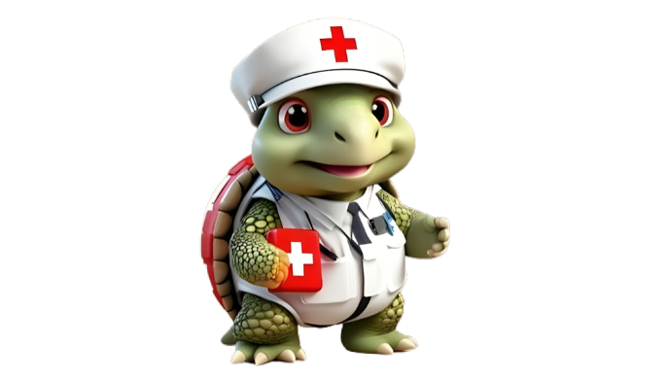

Environmental Emergencies
DEFINITION, IDENTIFICATION, CAUSES, SYMPTOMS, AND TREATMENT GUIDE

Slide 2
d. Heat Stroke

Slide 3

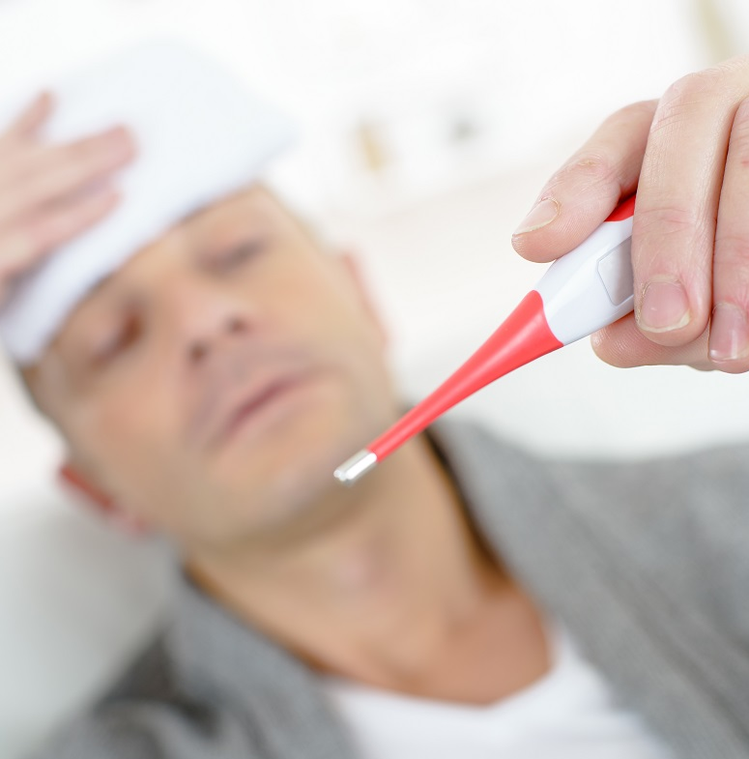
What is Heat stroke ?
Heat stroke is the most serious heat-related illness. It occurs when the body can no longer control its temperature: the body’s temperature rises rapidly, the sweating mechanism fails, and the body is unable to cool down. Fatal if the person does not receive emergency treatment.

Slide 4
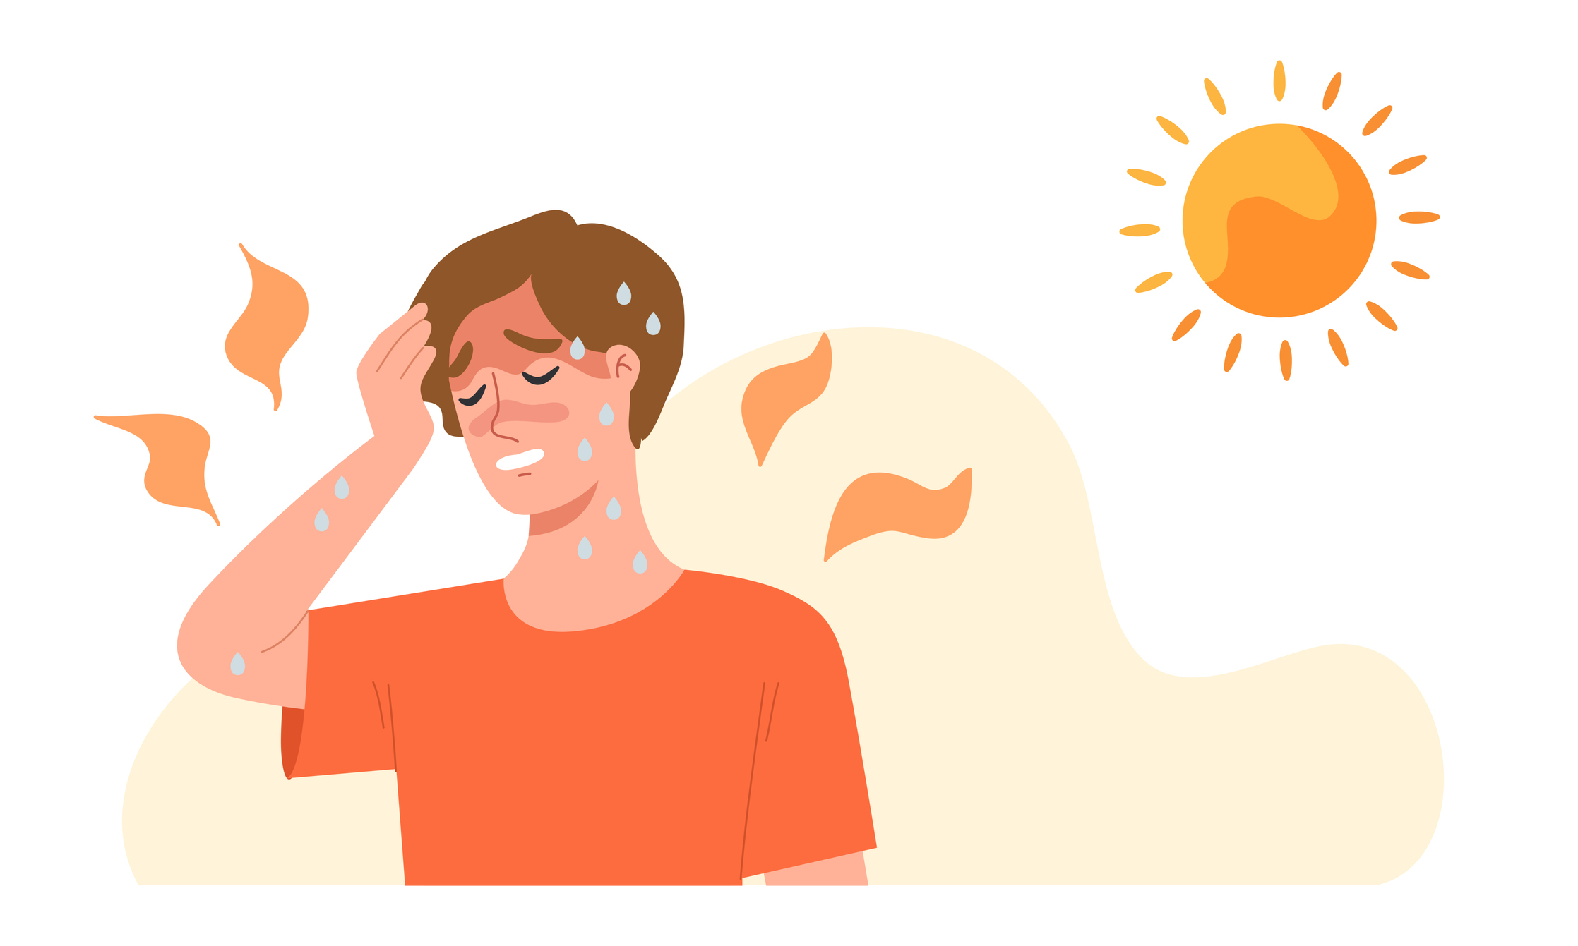

How to identify if someone is having a Heat stroke?
Indicator 1
Very High Body Temperature above 40°C (104°F), Nausea
Indicator 2
Sudden confusion, Slurred speech, Blurred vision

Slide 5
Symptoms and causes of Heat stroke

Slide 6
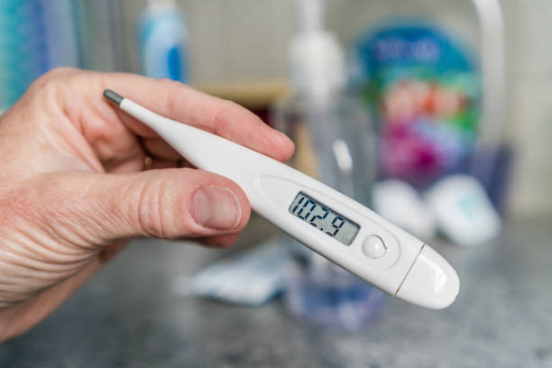


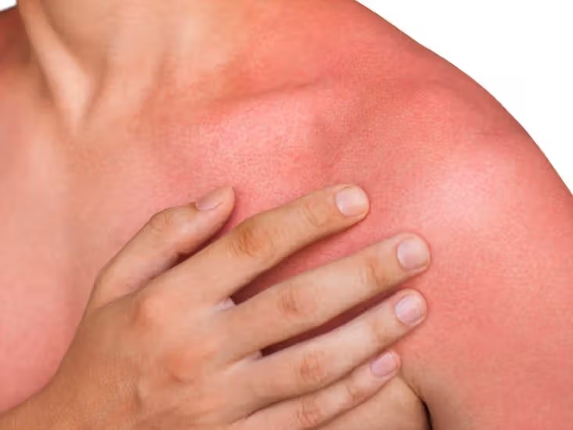
02.
04.
VERY HIGH BODY TEMPERATURE
TROUBLE SPEAKING AND UNDERSTANDING WHAT OTHERS ARE SAYING
01.
HOT, DRY, FLUSHED SKIN
03.
HEADACHE, DIZZINESS, NAUSEA

Slide 7
What to do?

Slide 8
Call for emergency medical help immediately, until the help arrives
Move the person to a cooler / shaded place and remove their outer clothing.
Person affected must be cooled immediately, using these methods:
- A cold water / ice bath if possible,
- Placing cold wet cloths on the skin
- Circulating cold air around to speed cooling
- Place cold wet cloths or ice on the head, neck, armpits or groin
While waiting for help to arrive keep checking their temperature, breathing, pulse, level of response.
If they start getting hot again, repeat the cooling process.

Slide 9
ASSESSMENT
Which of the following symptoms is NOT typically associated with heatstroke?
  High fever (above 40°C)
  Throbbing headache
  Chills and shivering
  Dry, flushed skin
What is the FIRST step you should take if you suspect someone is suffering from heatstroke?
  Move them to a cool, shaded area
  Call emergency services from the same place
  Take their temperature
  Apply ice packs to their forehead.
Drinking plenty of water throughout the day can help prevent heatstroke.
  True
  False
Answer: 1) c 2) b, c 3) a

Slide 10
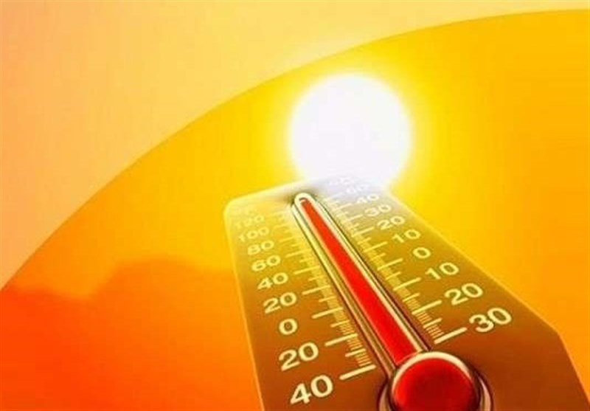
REFRESHER
Heat stroke is a severe heat-related illness where the body cannot control its temperature, leading to rapid temperature rise, failure of sweating, and inability to cool down.
Symptoms include hot, dry skin, difficulty speaking, headache, dizziness, nausea, and high body temperature.
Emergency management involves calling for medical help, moving to a cooler, and removing clothing.
Cooling methods include cold water or ice baths, placing wet cloths on the skin, and circulating cold air.
Monitoring temperature, breathing, pulse, and response is crucial, and repeating the cooling process if necessary.

Slide 11
Thank you for your attention, It may save a life one day
FOR MORE INFORMATION CONTACT +91 9911772407 OR EMAIL AT INFO@INFINITI8.ORG

