Slide 1
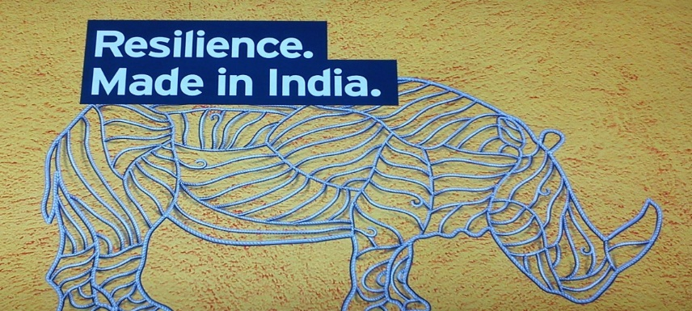
Institution for Disasters, Emergency & Accidents (IDEA)
An ISO 9001:2008 Accredited Organization
www.innovoidea.in
SAFE, SMART & RESILIENT
INDIA
IDMP – Integrated Disaster Management Programme

Slide 2
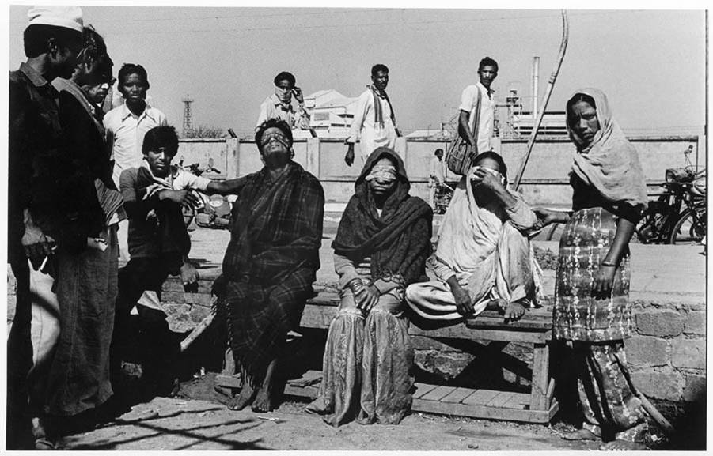
Fundamentals of Disaster Management Presentation on Chemical Disasters

Slide 3
Disasters
Meaning: Disaster is a certain calamitous event bringing great loss destruction devastation to property and lives of living beings.
Definition: Alexander in 1993,define disaster as some rapid, instantaneous or profound impact of natural environment upon the socio economic system.

Slide 4
Classification of disaster
Natural disaster
Man-made & human induced disaster
Volcanic eruption
Earthquake
Tsunami
Tornado
Cyclone
Cloud burst
Landslides
Avalanches
Floods
Wars
Chemical & Industrial disasters
Nuclear accidents
Oil spills
Terrorism
Pollution
Traffic accidents
Conflicts/riots

Slide 5
Chemical disaster
Major chemical hazards are generally associated with the potential for fire, explosion or dispersion of toxic chemicals and usually involve release of material from containment followed in the case of volatile material, by its vaporization and dispersion. Accidents involving major hazards could include.
Leakage of flammable material, mixing of the material wit air, formation of flammable vapour cloud and drifting of cloud to a source of ignition, leading to fire and explosion, affecting the site & possibly populated area.

Slide 6
continued…….
Leakage of toxic material formation of a toxic vapour cloud and drifting of the cloud, affecting directly the site and possibly populated area.

Slide 7
Disaster Management Cycle
1.Recovery plans.
2. Crop inspection & Recovery.
3. Guiding people.
4. Forecasting, warning & prediction
2.
preparedness
1.
Mitigation
1.Estimation of losses.
2. Preparation of maps of affected area.
3. Protective engineering solutions.
4. Providing information to people
1.Provide food and rashan.
2.Mass media coverage.
3.Aid from different NGO’s
1.Separate place for animal grazing.
2.Plantation osn maximum area.
3.Construction of levees.
4.Use of natural fertilizers
3.
relief
4.Rehabilitation & reconstruction

Slide 8
Chemical Disaster Mitigation
Two main stakeholders at state level i.e. District authorities and Industry.
Ministry of environment and forest, at national level.
FUNCTION OF DISTRICT AUTHORITY
Identification of hazardous installation.
Monitoring of such installation
Developing new approaches for accident prevention
Maintain coordination among stakeholders.
Enforcement mech. Should include suitable sanction,with non-compliance of any requirement.

Slide 9
Accident Prevention
Planning & construction of installation.
Monitoring and assessment of safety.
Promotion of training programe.
Fostering of public awareness.
Industry
Hazard identification
Engineering design as per building code
Construction by trained masons as per design by trained by trained architects.
Education & training.
Repair and modification
Safe storage of hazardous substance, under special consideration.
Monitoring by industry & district adm.

Slide 10
Major chemical disasters in India
Following the Bhopal Gas Disaster in 1984, incidences of include
a fire in an oil well in Andhra Pradesh (2003)
a vapour cloud explosion in the Hindustan Petroleum Corporation Limited Refinery (HPCL), Vishakhapatnam (1997)
an explosion in the Indian Petrochemicals Corporation Limited (IPCL) Gas Cracker Complex, Nagothane, Maharashtra (1990).
Over 20 major chemical accidents have been reported in MAH units during 2002–06.

Slide 12
Case study
Around 1 a.m. on Monday, the 3rd of December, 1984, In the city of Bhopal, Central India, a poisonous vapour burst from the tall stacks of the Union Carbide pesticide plant.
This vapour was a highly toxic cloud of methyl isocyanate.
2,000 died immediately
300,000 were injured
7,000 animals were injured, of which about one thousand were killed.

Slide 13
The affected area

Slide 14
Chemical process
The reaction involved two reactants, methyl isocyanate (MIC) and alpha naphthol.
The process begins with a mixture of carbon – monoxide and chlorine to form phosgene. Phosgene is then combined with monomethylamine to form MIC. MIC is further mixed with naphthol to produce the end product carbaryl.

Slide 15
The disaster(3/12/84)

Slide 16
Possible causes
A tank containing methyl isocyanate (MIC) leaked.
MIC is an extremely reactive chemical and is used in production of the insecticide carbaryl.
The scientific reason for the accident was that water entered the tank where about 40 cubic meters of MIC was stored.
When water and MIC mixed, an exothermic chemical reaction started, producing a lot of heat.
As a result, the safety valve of the tank burst because of the increase in pressure.
It is presumed that between 20 and 30 tonnes of MIC were released during the hour that the leak took place.
The gas leaked from a 30 m high chimney and this height was not enough to reduce the effects of the discharge.

Slide 17
Aftermath
UCC tries to shift blame on UCIL, sabotage etc
1985
Bhopal Gas Leak Disaster Act – GOI set up as solerepresentative of Bhopal victims
All cases transferred from US courts to Indian
1989
UCC accepts moral responsibility and settles out of court
for $470 million (of the original $3 billion)
UCC share rises $2 (i.e. up 7%)

Slide 18
IMMEDIATE RELIEF PROVIDED BY THE STATE GOVERNMENT:
Economic relief provided in Dec'84 | Rs.1.00 Crores
Relief provided to 78,800 families with monthly income less than Rs. 500/- | Rs. 11.80 Crores
Free food and milk supply to the victims | Rs. 19.20 Crores
Ex-gratia payment for death of 2246 animals | Rs.0.25 Crores
Compensation paid to family members of deceased victims (3787 deaths) at Rs. 10,000 per person | Rs.3.78 Crores
total | Rs.36.03 crore

Slide 19
Participation of govt & NGOS IN resecue operations.

Slide 20
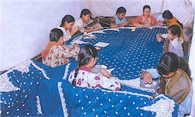
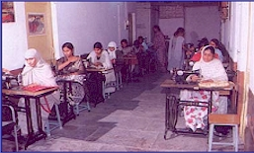
Rehabilitation
Economic

Slide 21
Social Rehabilitation
Scheme | Sanctioned under Action Plan | Expenditure upto March, 2009
Economic Rehabilitation | 21.18 | 27.06cr
Scheme | Sanctioned under Action Plan | Expenditure upto November, 2008
Social Rehabilitation | 49.72 | 45.69cr

Slide 22
Judicial Actions
The Environment protection act 1986
The factory act 1948(amended in 1976 & 1987)
Natural environment tribunal act 1995.
In cities like Delhi, hazardrous industries were shifted out of cities.

Slide 23
Situation now
• UCC shrunk to 1/6th its size since the disaster
• Restructuring places large portions of its assets out of legal reach of Bhopal victims (sold Bhopal plant in 1994)
• Still operates as subsidiary of Dow Chemicals
• Believes that the Bhopal disaster was a result of sabotage
(Arthur D. Little report)
UCIL Bhopal site not remediated
Plant still leaks toxic chemicals
1999 analysis of groundwater shows
20,000 times permissible amount of mercury
50 times permissible amount of trichloroethane
2002 tests show chlorinated organics, lead and mercury in
breast milk of nursing mothers

Slide 24
conclusion
The Bhopal gas tragedy could have been averted.
There were lapses on part of the government and UCC.
The actual reason for the tragedy is contrary to popular belief.
An alternate way to produce carbaryl was suggested.
Design of Inherently safer process was required.

Slide 25
Questions?

Slide 26
IDMP – Integrated Disaster Management Programme
Institution for Disasters, Emergency & Accidents (IDEA)
An ISO 9001:2008 Accredited Organization.
VISIT US @ www.innovoidea.in
MAIL US @ myinnovoidea@gmail.com
CALL US @ 88-66-55 24 07
99-58-07-8075
99-68-05-18-94
99-71-85-10-43
99-71-32-80-89
SAFE, SMART & RESILIENT
INDIA
INDULGE with DESIRE , EMERGE though ACTIONS .

