Slide 1
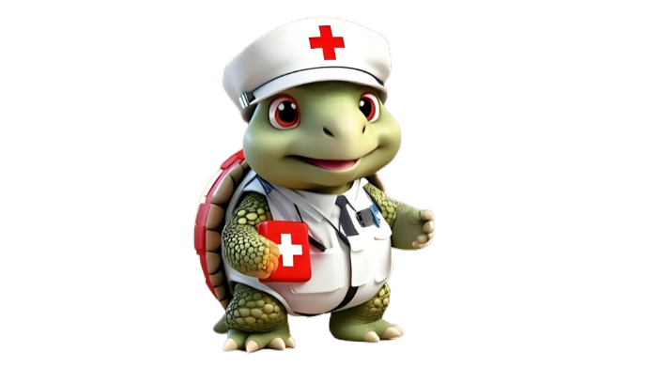
Environmental Emergencies
DEFINITION, IDENTIFICATION, CAUSES, SYMPTOMS, AND TREATMENT GUIDE

Slide 2
a) Drowning

Slide 3
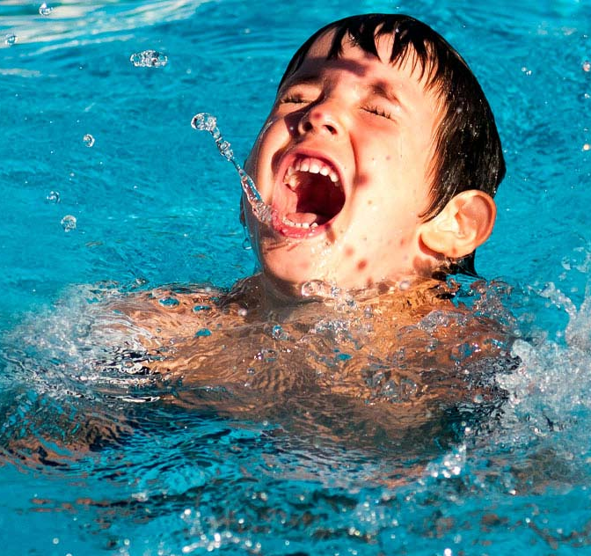
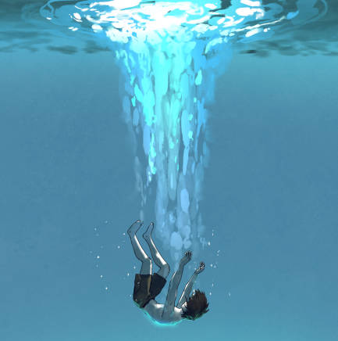
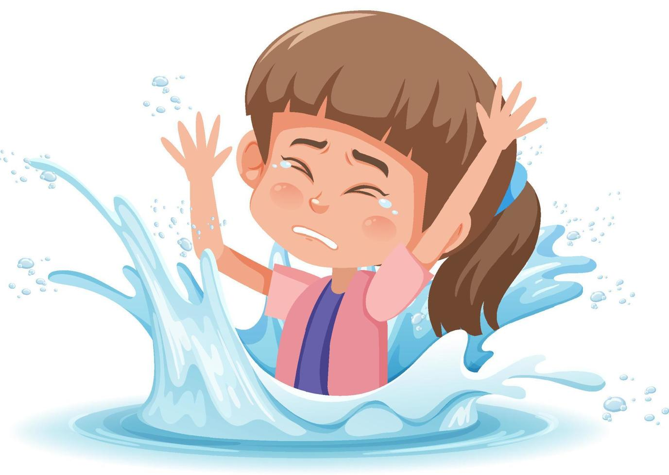
What is Drowning ?
Drowning is the process of experiencing respiratory impairment from submersion or immersion in a liquid (regardless of outcome).

Slide 4
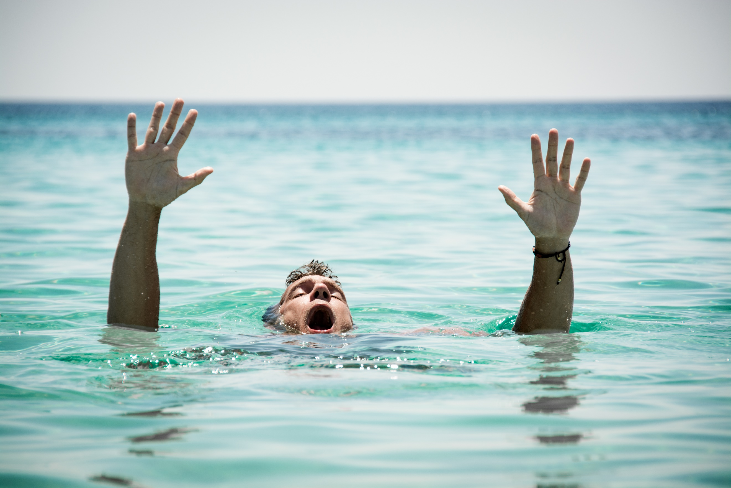
How to identify if someone is drowning ?
Silent: There’s no spare breath to call for help.
Bobbing up and down: Their mouth could dip below the water’s surface, pop up just enough to breathe, and sink back down.
Still: Their body could be straight up and down, almost like they're standing in the water. You won't see kicking or flailing.
Stiff-armed: Instead of waving for help, someone who's drowning may have their arms out to the side. They most likely can't reach out to grab a life preserver.

Slide 5
Major Causes of Drowning

Slide 6
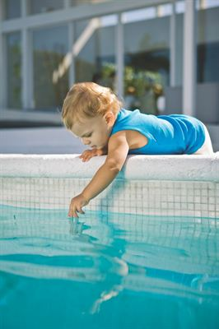
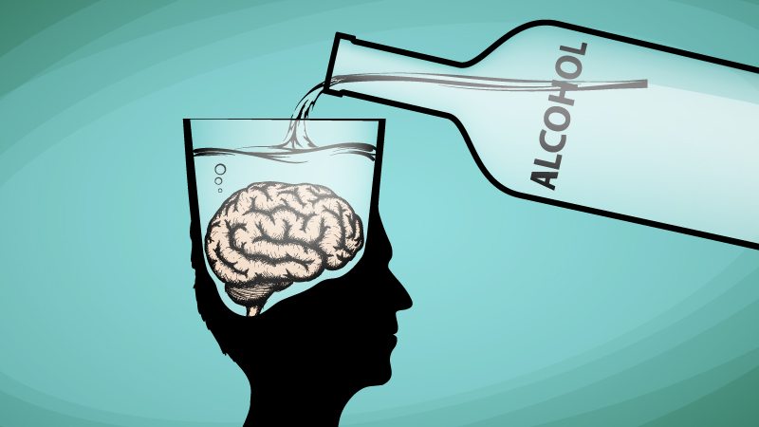
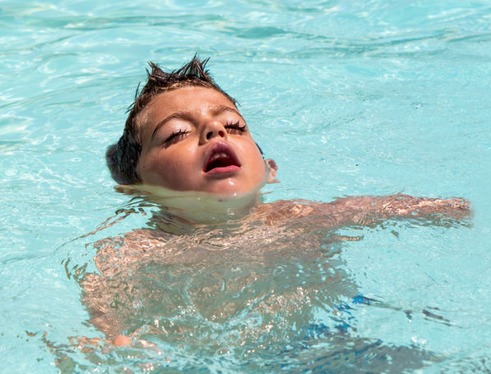
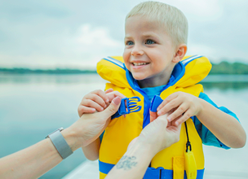
02.
04.
Alcohol use.
No barriers around the water activity areas.
Lack of supervision.
01.
Not being able to swim
03.
Failure to wear life jackets.

Slide 7
What to do?

Slide 8
Call for Emergency medical Help when -
- Someone is drowning.
- A child is having problems breathing or has stopped breathing as a result of being underwater. (Remember, children can drown in as little as 1 inch of water.)
- A child had a near-drowning incident.
First aid for drowning :
Call for Emergency medical services and until they arrive,
Move the person – Quickly and Safely move the person out of water.
Check to see if they’re conscious – Tap the shoulder and shout.
If they don’t respond, place them on their back.
Start CPR – Follow ABC (Airway – Breathing - Circulation) sequence starting with 5 initial rescue breaths and 30 chest compressions.
Continue this until Signs of life reappear, Rescuer becomes exhausted or Advanced life support becomes available.

Slide 9
ASSESSMENT
Which of the following is a common sign that someone may be drowning?
Loud shouting for help
Treading water with ease
Floating calmly on the surface
Struggling to keep their head above water and gasping for air.
You arrive at a pool party to find a teenager lying by the poolside, unresponsive and gasping for air. They cough up pink frothy liquid and seem confused. What is the MOST likely immediate action you should take?
Start CPR
Administer first aid
Call emergency services
Place them on their side in the recovery position
Answer: 1) d 2) c

Slide 10
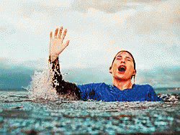
REFRESHER
Drowning is a respiratory impairment caused by submersion or immersion in liquids.
It is identified by silent, bumbling, stiff-armed, and still states.
Major causes include inability to swim, lack of supervision, failure to wear life jackets, and alcohol use.
Management involves calling emergency medical services, moving the person out of water, checking if they are conscious, placing them on their back, and starting CPR.
This process continues until signs of life reappear, rescuer exhausts, or advanced life support becomes available.
Every drowning signals the failure of the most effective intervention — namely, PREVENTION

Slide 11
Thank you for your attention, It may save a life one day
FOR MORE INFORMATION CONTACT +91 9911772407 OR EMAIL AT INFO@INFINITI8.ORG

