Slide 1


Environmental Emergencies
DEFINITION, IDENTIFICATION, CAUSES, SYMPTOMS, AND TREATMENT GUIDE

Slide 2
e. Cold Injury
Hypothermia, Frostbites

Slide 3
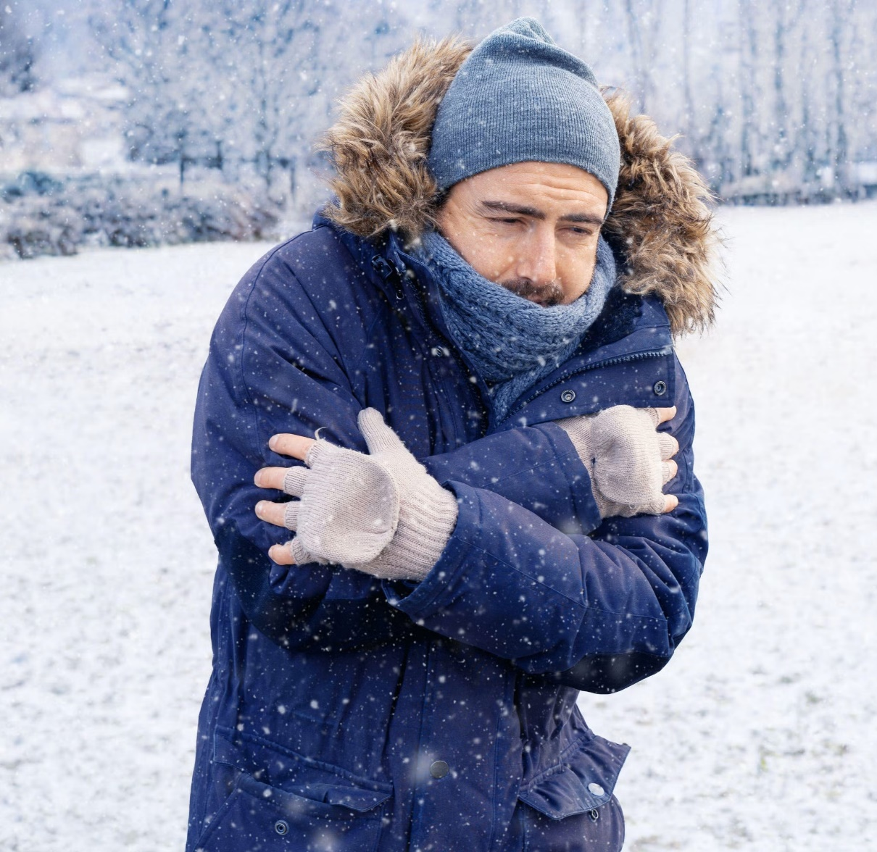
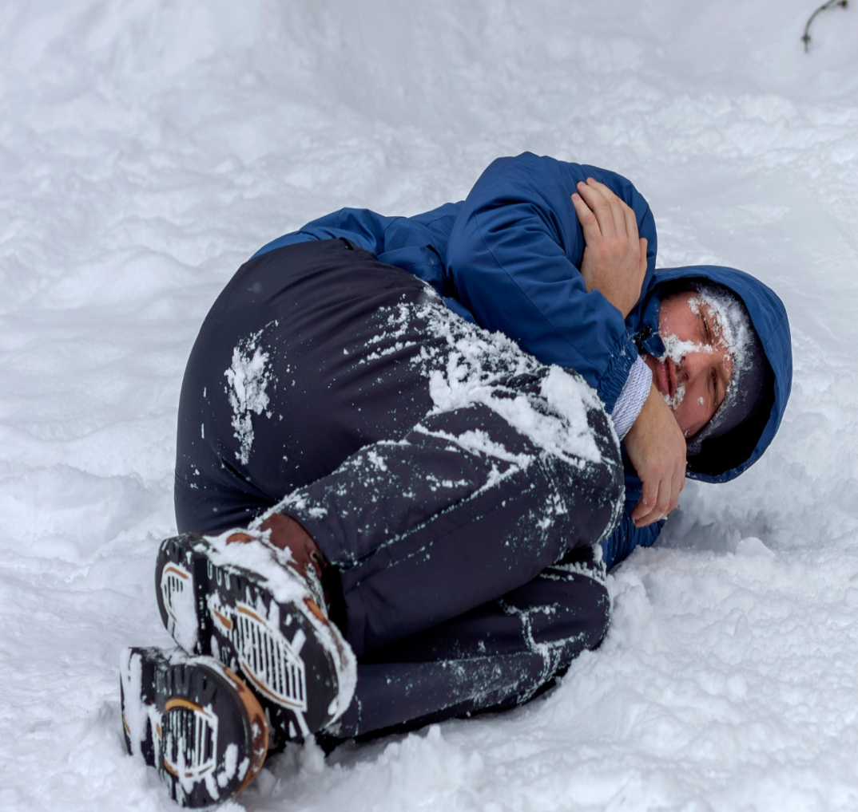
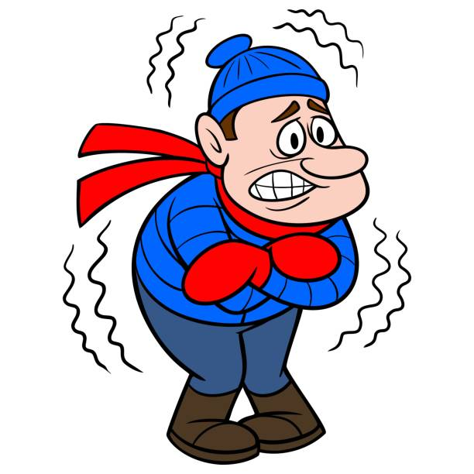
What is Hypothermia & Frostbite ?
Hypothermia and Frostbite are cold-related emergencies that may quickly become life or limb threatening.
Hypothermia - Hypothermia is the cooling of the body’s core temperature (<35°C) caused by the failure of the body’s warming system.
Frostbite - Frostbite is the freezing of a specific body part such as fingers, toes, the nose or earlobes.

Slide 4
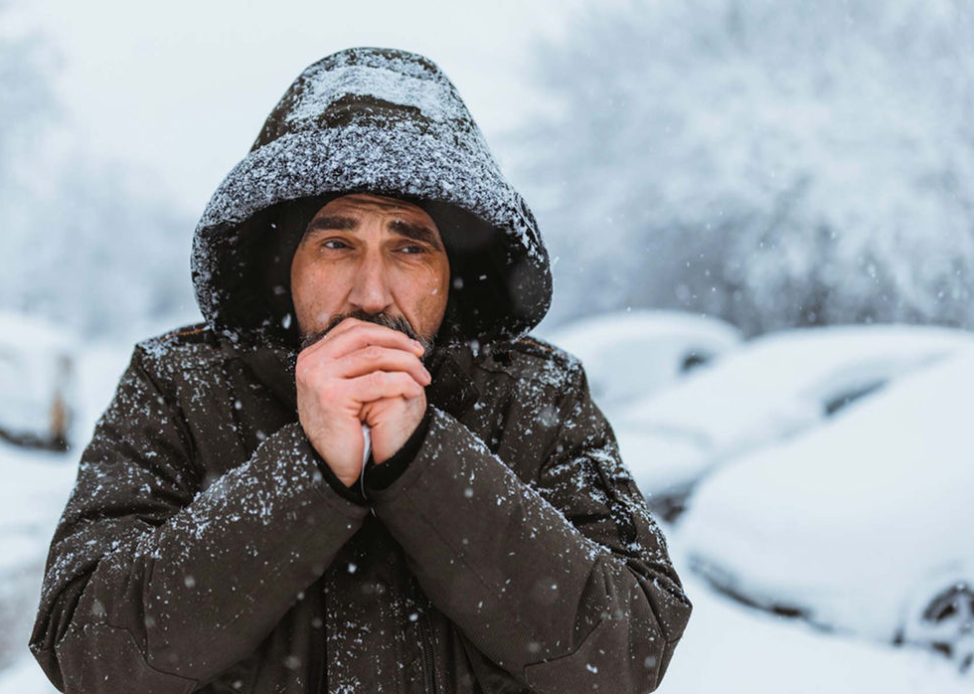

How to identify if someone is facing Hypothermia / Frostbite ?
Hypothermia
SHIVERING, NUMBNESS, WEAKNESS, LOSS OF CONSCIOUSNESS
Frostbite
LACK OF FEELING IN THE AFFECTED AREA, SKIN WILL APPEAR WAXY, DISCOLORED

Slide 5
Symptoms of Hypothermia / Frostbite

Slide 6
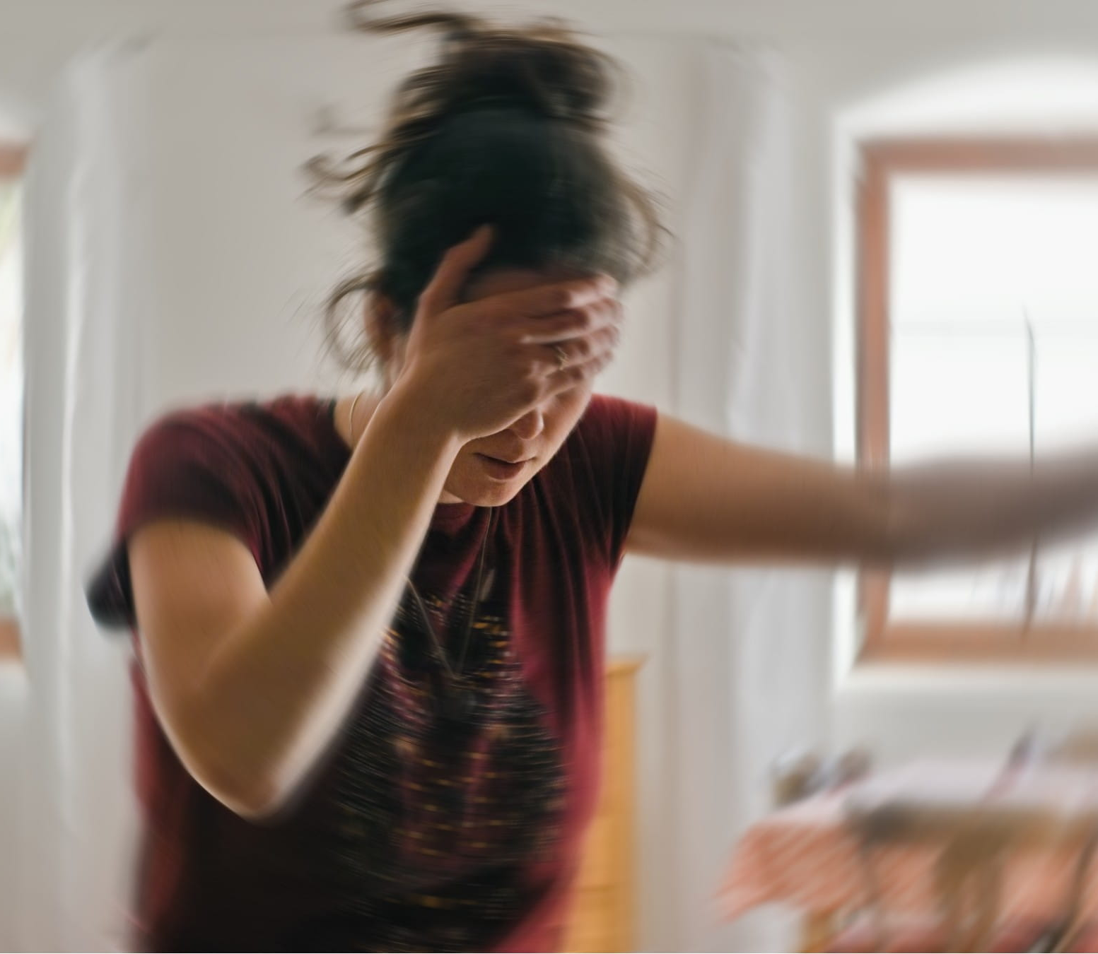
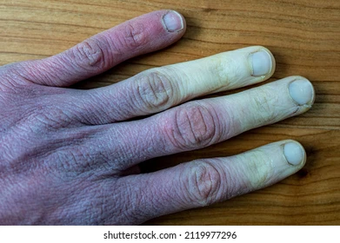
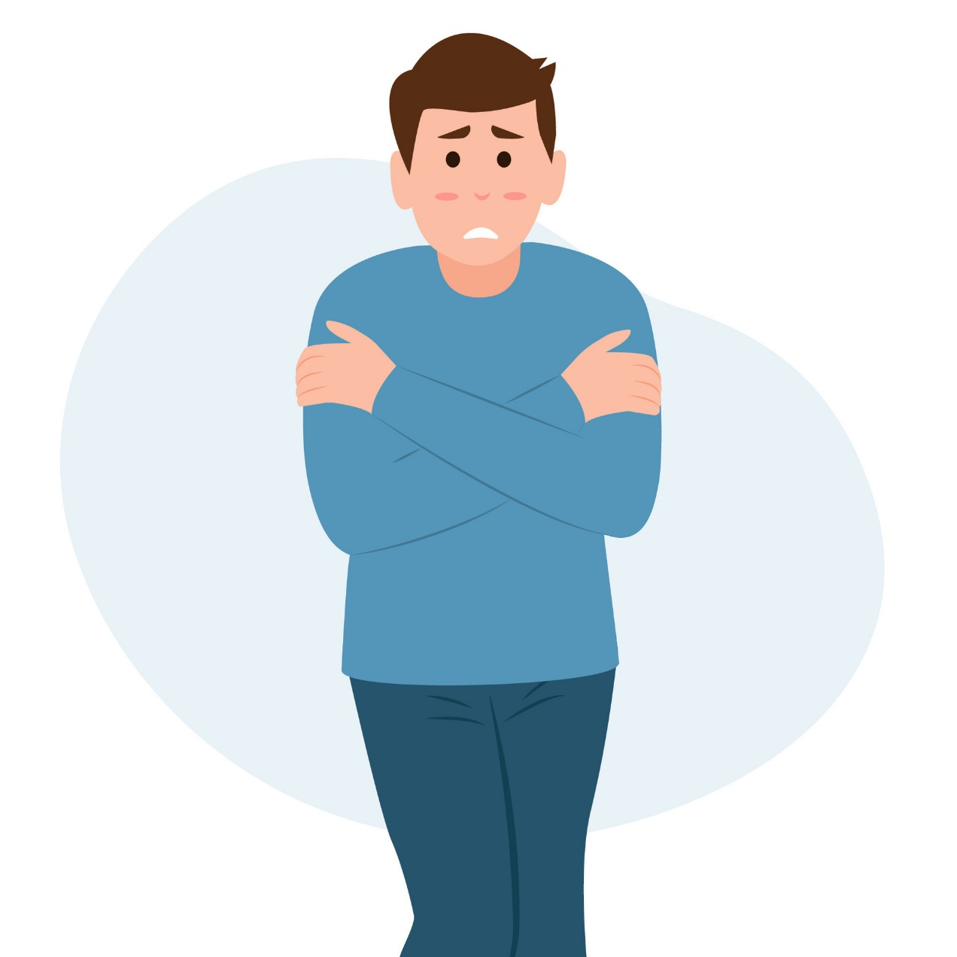
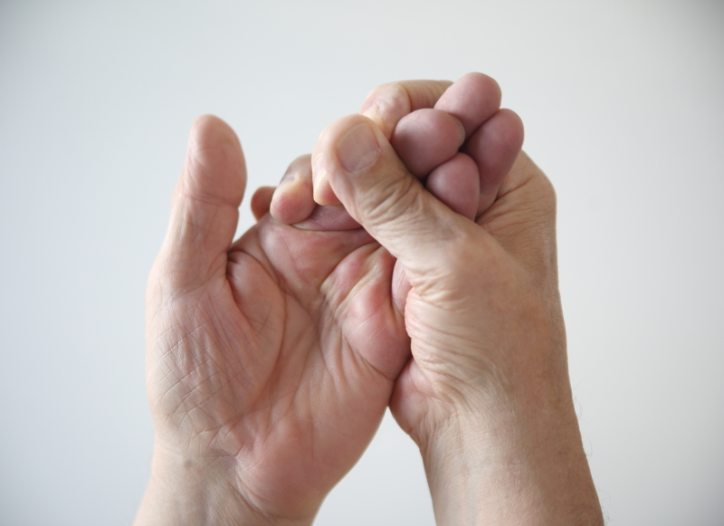
02.
04.
SKIN WILL APPEAR WAXY, COLD TO TOUCH OR DISCOLORED
IMPAIRED JUDGEMENT, LOSS OF CONSCIOUSNESS
01.
SHIVERING, NUMBNESS, WEAKNESS
03.
LACK OF FEELING IN AFFECTED AREA

Slide 7
What to do?

Slide 8
HYPOTHERMIA
Call for Emergency medical help immediately.
Be Gentle: Until the emergency help arrives, gently move the person to a warm, dry location if possible. If you cannot move the person, shield them from cold and wind as much as possible.
Remove Wet clothing: If the person is wearing wet clothing, remove it.
Cover & Insulate: If you’re outside lay the person on a blanket or warm surface, use layers of dry blankets or coats to warm the person. Cover the person’s head leaving only face exposed.
Monitor breathing: If the person’s breathing is dangerously low or stopped begin Rescue breathing and CPR.
Warm beverages & compresses: If the affected person is alert and able to swallow, provide them warm, sweet beverages(Non-alcoholic, Non-caffeinated) to help warm the body. Use warm and dry compresses to warm the core first, do not warm the extremities (hand, legs).
FROSTBITE
Check for Hypothermia: Get Emergency medical help if hypothermia is suspected.
Get out and Rewarm: Get into a warm space and soak the frostbitten areas in gentle warm water until it appears red, warm and loses it numbness.
Cover it: Loosely bandage the whole rewarmed area with dry, sterile dressing. If fingers or toes are frostbitten, place dry, sterile gauze between them to keep them separated.
Do not: Do not apply snow or rub the affected areas. Do not attempt treatment in fields if there is chance of refreezing, if you allow the rewarmed area to refreeze it may result in extensive injuries and greater damage. Do not break any blisters. Do not rewarm frostbitten skin in direct heat.
Seek professional medical care as soon as possible.

Slide 9
ASSESSMENT
Imagine you're caught in a snowstorm and start shivering uncontrollably. Which symptoms, in addition to shivering, might indicate the onset of hypothermia? (Choose all that apply)
  Slurred speech or confusion
  Stiff muscles and difficulty moving
  Drowsiness or feeling detached
  Pale or blue-tinged skin
  Rapid heartbeat or shallow breathing
You find a fellow hiker with white or numb fingers after a long trek in subfreezing temperatures. What is the FIRST THING you should NOT do?
  Remove any wet or constricting clothing from the affected area.
  Gently rewarm the frostbite areas with lukewarm water (100-105°F).
  Apply gentle pressure to the affected area to restore circulation.
  Rub or massage the frostbite areas to try and warm them faster.
  Wrap the affected area loosely with a clean, dry cloth or blanket.
Answer: 1) a, b, c, d 2) d

Slide 10
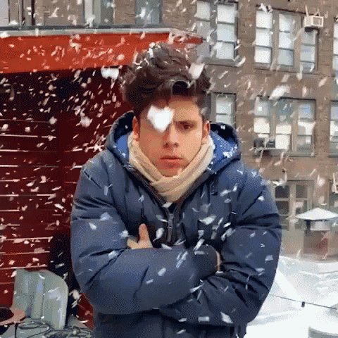
REFRESHER
Hypothermia and Frostbite are cold-related emergencies that can quickly become life or limb threatening.
Hypothermia is the cooling of the body's core temperature (<35°C) due to the failure of the body's warming system. Frostbite is the freezing of a specific body part, such as fingers, toes, the nose, or earlobes.
Symptoms may include shaking, numbness, weakness, loss of consciousness, lack of feeling in the affected area, a waxy, or discolored skin.
Emergency management for hypothermia involves calling for medical help, being gentle, moving the person to a warm, dry location, removing wet clothing, covering and insulating, monitoring breathing, and providing warm beverages and compresses.
For Frostbite, check for hypothermia, rewarm the affected area, bandage it with dry, sterile dressing, and avoid applying snow or rubbing the affected areas. Seek professional medical care as soon as possible and avoid refreezing the affected area.

Slide 11
Thank you for your attention, It may save a life one day
FOR MORE INFORMATION CONTACT +91 9911772407 OR EMAIL AT INFO@INFINITI8.ORG

