Slide 1
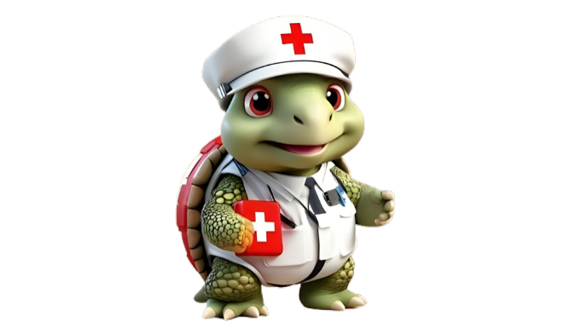

Environmental Emergencies
DEFINITION, IDENTIFICATION, CAUSES, SYMPTOMS, AND TREATMENT GUIDE

Slide 2
b. Burns

Slide 3
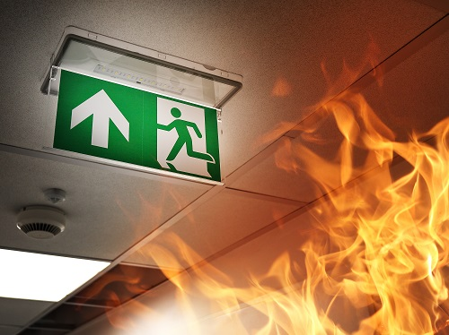
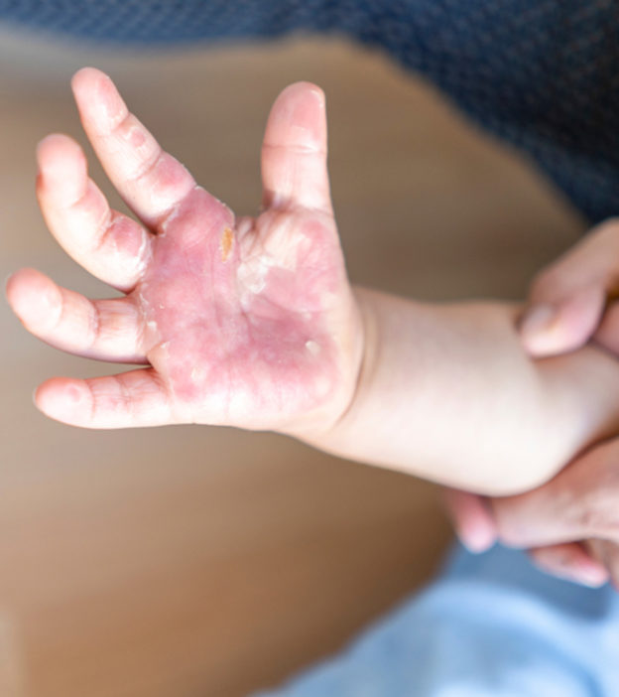
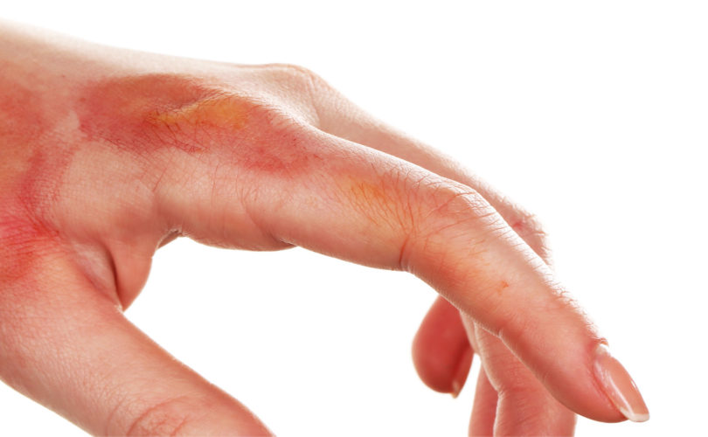
What are Burns ?
A burn is a type of injury to the skin or other tissues caused by heat, electricity, chemicals, or radiation. The severity of a burn is categorized into degrees, with first-degree being the least severe and third-degree the most severe.

Slide 4

Types of Burns
First-Degree Burns
Superficial burns that affect the outer layer of the skin (epidermis).
Symptoms include redness, pain, and minor swelling.
Typically heal without scarring.
Second-Degree Burns:
Affect both the outer layer (epidermis) and part of the underlying layer (dermis).
Symptoms include blistering, severe pain, swelling, and redness.
Can result in scarring.
Third-Degree Burns:
Penetrate the entire thickness of the skin, affecting underlying tissues.
Skin may appear white, charred, or leathery.
Often painless due to nerve damage.
Require immediate medical attention.

Slide 5
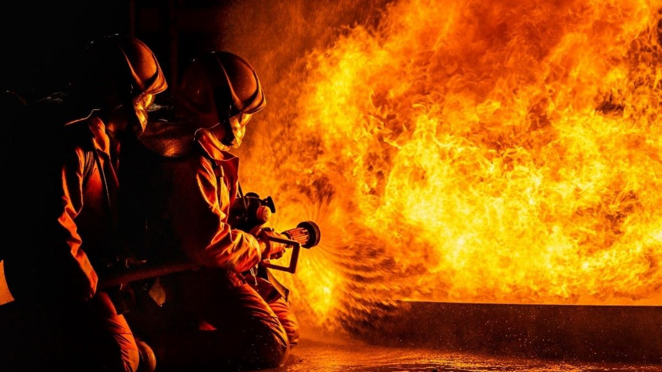
Identifying Burns
Extent of Redness or Discoloration
First-degree burns: Mild redness.
Second-degree burns: More intense redness, blistering.
Third-degree burns: Skin may be white, blackened, or charred.
Pain Level
First-degree burns: Mild to moderate pain.
Second-degree burns: Severe pain.
Third-degree burns: May not be painful due to nerve damage.
Presence of Blisters
Blisters are common in second-degree burns.
Depth of Injury
Superficial (first-degree) or partial-thickness (second-degree) burns affect specific layers of the skin.

Slide 6
Causes of Burns

Slide 7
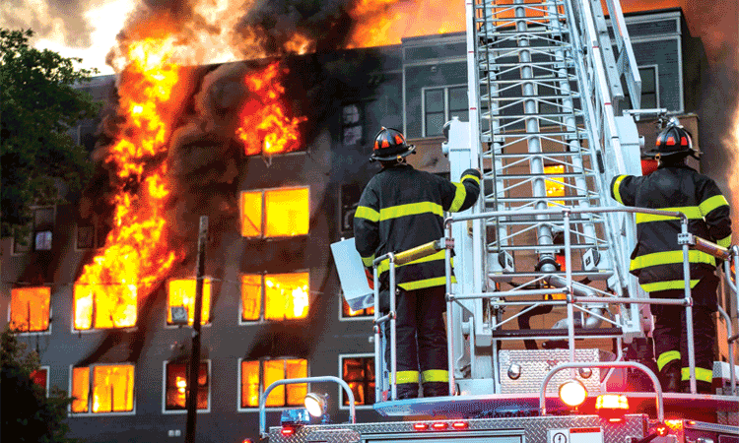
Causes of Burns
Heat
Scalds from hot liquids
Contact with hot surfaces
Flames from fires
Chemicals
Contact with corrosive substances.
Radiation
Exposure to the sun (sunburn).
Radiation therapy.
Electricity
Contact with electrical currents.

Slide 8
Symptoms of Burns

Slide 9
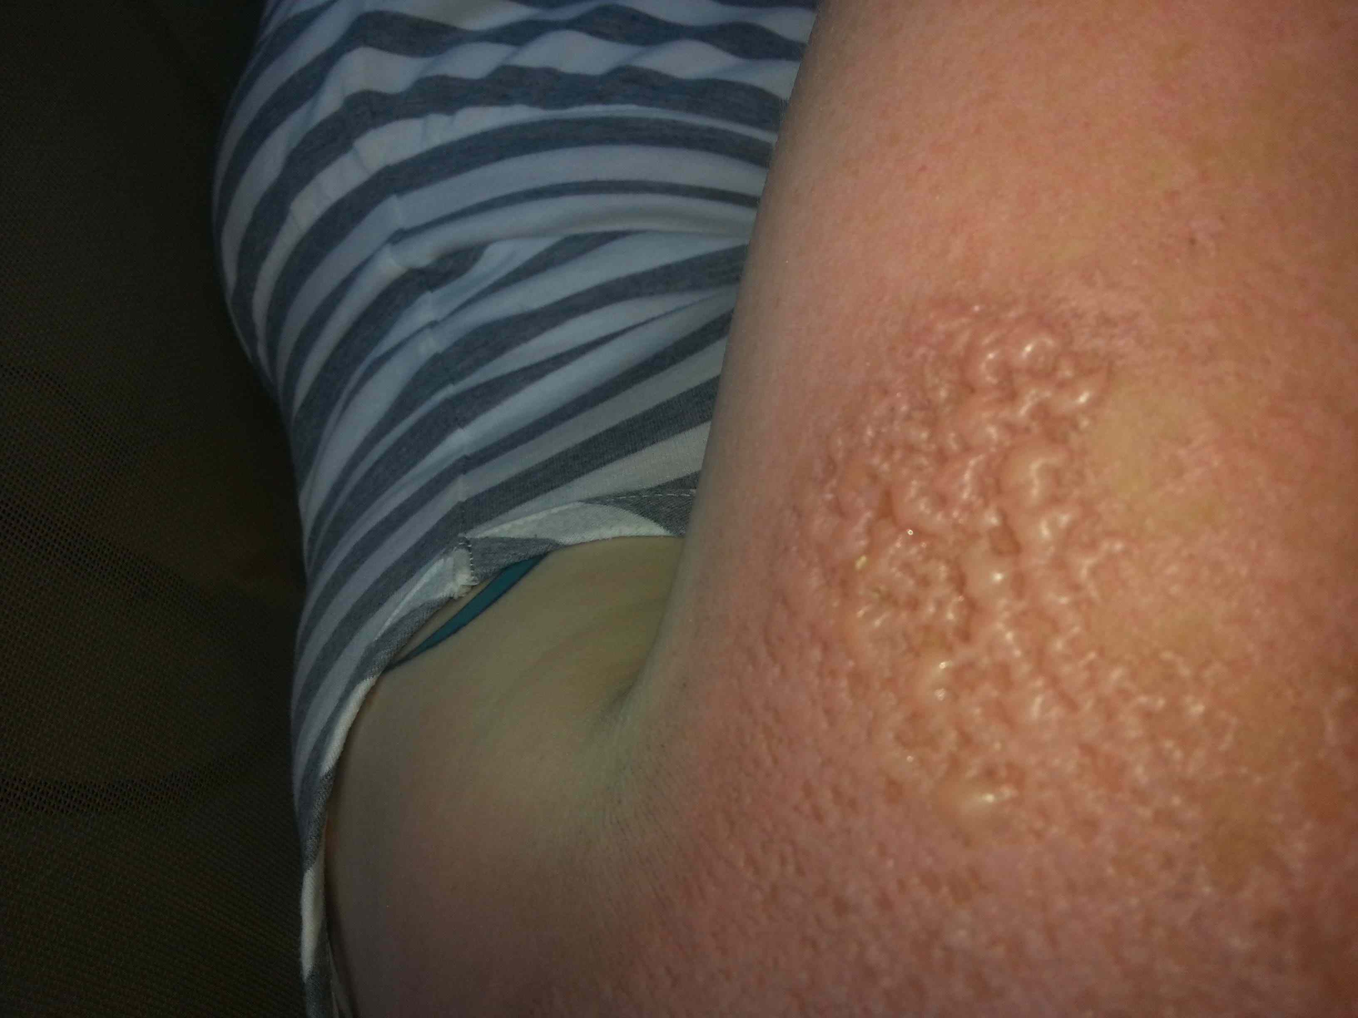
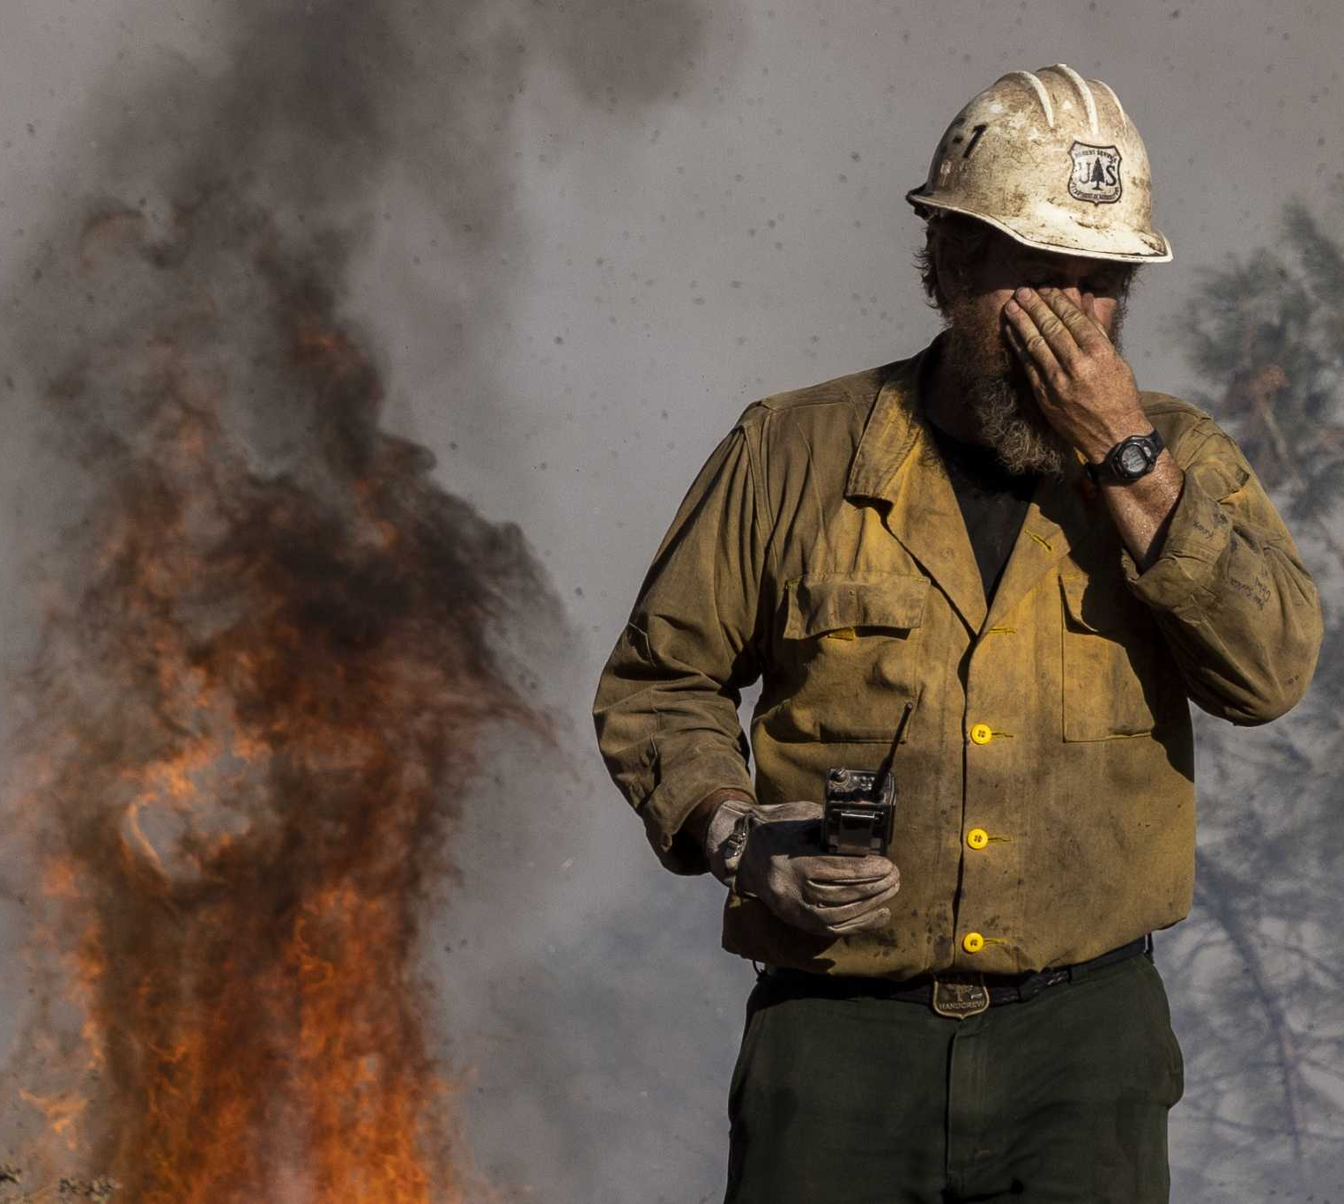
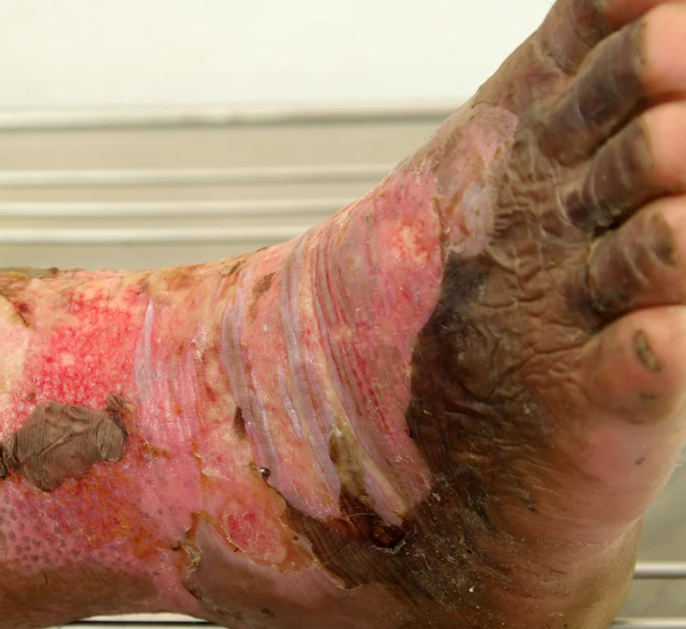
02.
04.
Inhalation injury -Difficulty breathing / coughing
Blisters
01.
Redness, swelling and pain
03.
Charred or Leathery skin

Slide 10
What to do?

Slide 11
For Minor Burns
Cool the burn: Hold the area under cool (not cold) running water for about 10 minutes. If the burn is on the face, apply a cool, wet cloth until the pain eases. For a mouth burn from hot food or drink, put a piece of ice in the mouth for a few minutes.
Remove rings or other tight items from the burned area: Try to do this quickly and gently, before the area swells.
Don't break blisters: Blisters help protect against infection. If a blister does break, gently clean the area with water and apply an antibiotic ointment.
Apply lotion: After the burn is cooled, apply a lotion, such as one with aloe vera or cocoa butter. This helps prevent drying and provides relief.
Bandage the burn: Cover the burn with a clean bandage. Wrap it loosely to avoid putting pressure on burned skin. Bandaging keeps air off the area, reduces pain and protects blistered skin.
If needed, take pain reliever, such as ibuprofen
For Major Burns
Seek Emergency medical help immediately, until the help arrives
Protect the burned person from further harm: If you can do so safely, make sure the person you're helping is not in contact with the source of the burn. For electrical burns, make sure the power source is off before you approach the burned person. Don't try to remove clothing stuck in the burn.
Make certain that the person burned is breathing: If needed, begin rescue breathing if you know how.
Remove jewelry, belts and other tight items, especially from the burned area and the neck. Burned areas swell quickly.
Cover the burn: Loosely cover the area with gauze or a clean cloth.
Raise the burned area: Lift the wound above heart level if possible.
Watch for signs of shock. Signs and symptoms include cool, clammy skin, weak pulse and shallow breathing.

Slide 12
ASSESSMENT
Imagine you accidentally touch a hot pan, leaving a red mark on your skin. Which of these features best describes the severity of your burn? (Choose one)
  Image of Sunburn: Redness, mild discomfort, no blistering - First-degree burn (minor)
  Image of Second-degree burn with blisters: Redness, blistering, some pain - Second-degree burn (partial thickness)
  Image of Third-degree burn with charred skin: White or charred skin, no sensation - Third-degree burn (full thickness)
You witness someone spill hot coffee on their arm, causing redness and blisters. What is the FIRST THING you should do? (Choose one)
  Apply ice or cold compress to the burn.
  Run the burn under cold water for 10-20 minutes.
  Apply lotion or ointment to the burn.
  Cover the burn loosely with a clean cloth.
Answer: 1) a 2) b

Slide 13
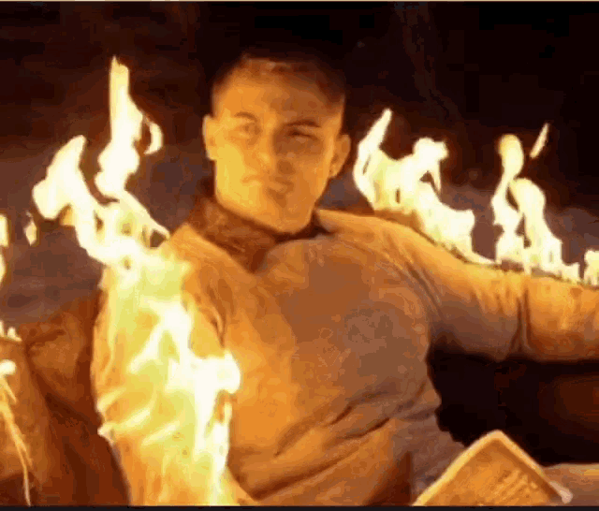
REFRESHER
Burns are injuries caused by heat, electricity, chemicals, or radiation, with severity categorized into degrees. First-degree burns are mild redness, while second-degree burns are more intense and blistering. Pain levels vary, with first-degree burns being mild to moderate and second-degree burns being severe. Symptoms include redness, swelling, pain, blisters, charred or leathery skin, and difficulty breathing.
Emergency management involves cooling the burn, removing tight items, and applying lotion. Bandaging the burn with a clean bandage helps prevent drying and provides relief. Pain relievers like ibuprofen can be taken if needed. For major burns, seek emergency medical help immediately.
Protect the burned person from further harm, ensuring they are not in contact with the source of the burn. If necessary, start rescue breathing if possible. Remove jewelry, belts, and tight items from the burned area and neck. Cover the burn with gauze or a clean cloth, and raise the wound above heart level if possible. Watch for signs of shock, such as cool, clammy skin, weak pulse, and shallow breathing.

Slide 14
Thank you for your attention, It may save a life one day
FOR MORE INFORMATION CONTACT +91 9911772407 OR EMAIL AT INFO@INFINITI8.ORG

