Slide 1
Environmental Emergencies
DEFINITION, IDENTIFICATION, CAUSES, SYMPTOMS, AND TREATMENT GUIDE

Slide 2
c. Bites and Stings

Slide 3
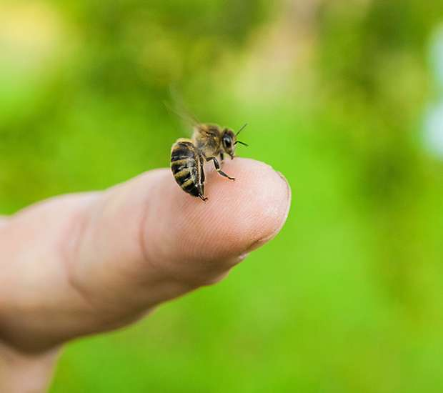
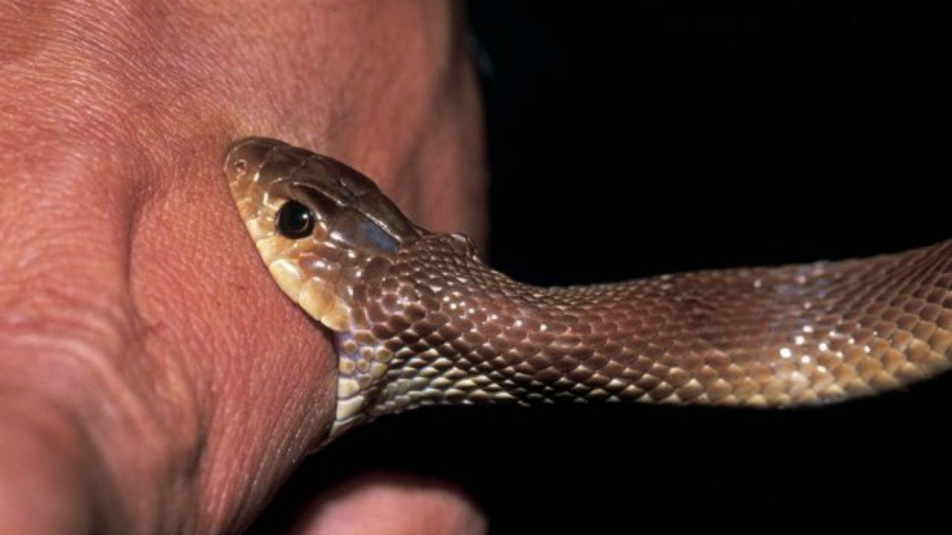
What are Bites and Stings ?
Wounds caused by piercing or stinging of the flesh of a person by an
animal, insect or by another person
Bites – Bites may cause injuries like scratches to extensive wounds with the risk of getting infected with bacteria from the mouth of the biting creature.
Stings – Certain Insects can inject venoms through their mouthparts or a stinger. Even mildly toxic venoms can cause serious allergic reactions.

Slide 4
How to identify if someone got bitten or stung ?
Animal Bites
Animal bites usually have teeth marks and puncture wounds with little scratches to extensive wounds
Snake Bites
Fang marks : presence of two puncture wounds indicate a bite by a poisonous snake
Insect Stings
Sting may be still there in the wound.
Sharp pain at the site of the sting with central reddened puncture wound.

Slide 5
Symptoms after bites / stings

Slide 6
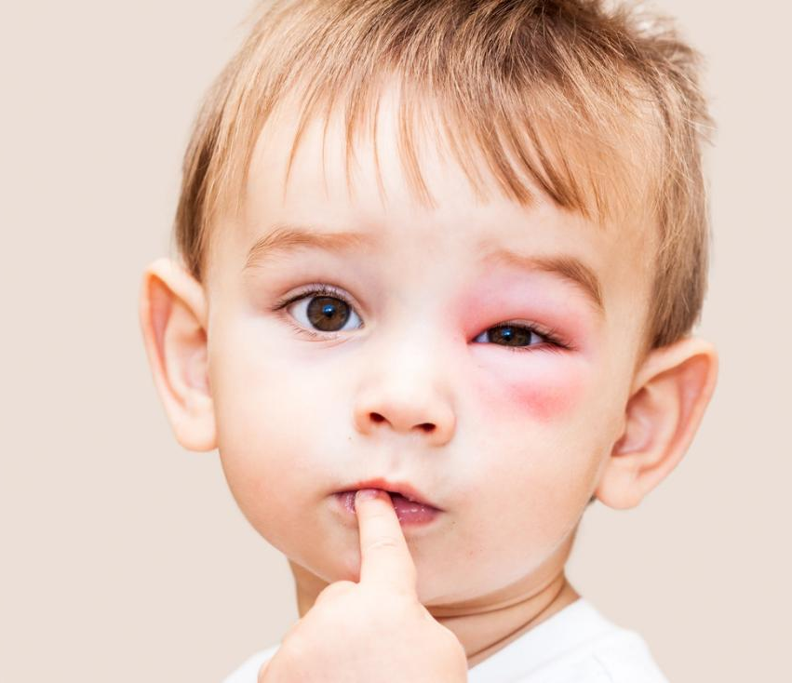
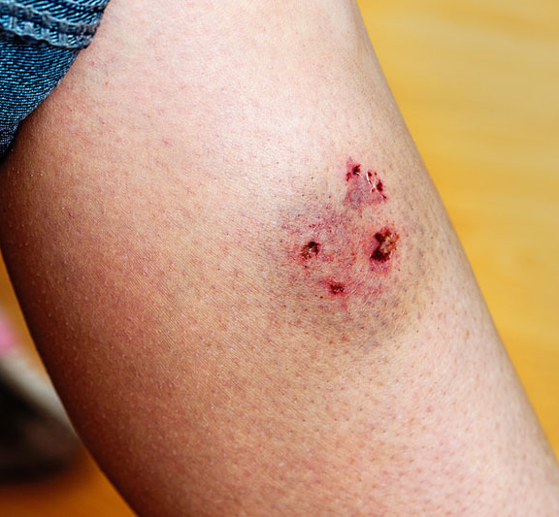
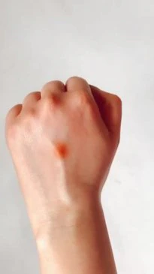
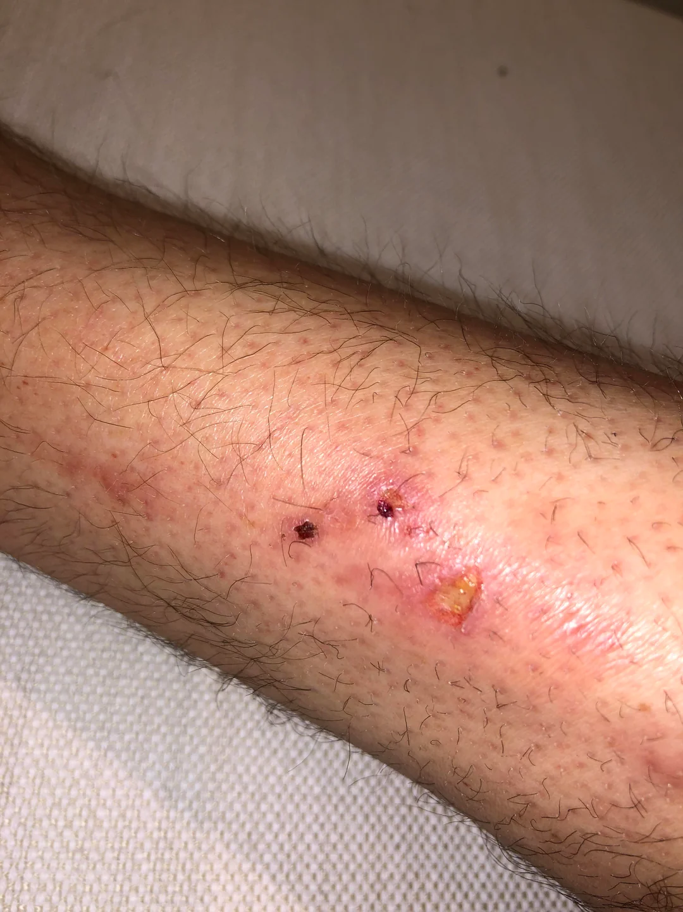
02.
04.
Dog bites may have teeth marks and several puncture wounds.
Swelling of face, tongue, rash patches in skin can be seen.
01.
Insect stings have single puncture wound causing swelling around the affected area and sharp pain at the point of sting
03.
Snake bites will have two puncture wounds with burning, throbbing pain.

Slide 7
What to do?

Slide 8
Animal Bites
Wash the wound well with soap and flush with running water.
Apply antiseptic lotion such as Betadine if bleeding has stopped.
Cover the wound with clean cloth or gauze.
Get to the Hospital Immediately.
Snake Bite – Use the ‘RIGHT’ approach
R – Reassure the person (70% of snakebites are from non-poisonous snakes, only 50% poisonous snakes inject poison)
I - Immobilize the affected body part of the person
GH – Get to the Hospital Immediately.
T - Tell the doctor of any systemic symptoms that manifests on the way to hospital.
Describe the snake clearly.
Insect Stings
Remove any remaining sting carefully.
Wash the wound well with soap and flush with running water.
If the body is showing symptoms such as Fever, allergic reactions such as swelling face, tongue or any breathing difficulties – Seek Emergency medical Help immediately or Get to the Hospital Immediately.

Slide 9
ASSESSMENT
Imagine you discover a small, red bump on your arm, accompanied by a sharp, burning sensation. You suspect it might be a bite or sting, but you're unsure by what. Which of these clues could help you identify the culprit?
Size and shape of the mark: Is it a single puncture or a series of dots? Is it round, oval, or elongated?
Pain level and sensation: Is it a sharp, burning pain, a dull ache, or something else? Does it feel itchy or numb?
Swelling and discoloration: Is the area swollen or puffy? Is there redness, bruising, or any other discoloration?
Presence of venom sacs or stingers: Can you see any remnants of a stinger or venom sacs near the wound?
Location and activity: Where on your body is the bite/sting? Were you active in an area known for specific insects or creatures?
If someone gets bitten, what is the FIRST thing you should do?
Apply ice or heat to the area.
Attempt to remove venom sacs or stingers if present.
Elevate the affected limb, if possible.
Wash the area gently with soap and water.
Ignore the bite/sting unless symptoms worsen.
Answer: 1) a,b,c,d 2) d

Slide 10
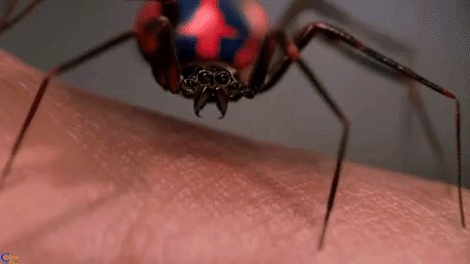
REFRESHER
Wounds caused by piercing or stinging of a person's flesh by animals, insects, or another person can result in injuries ranging from scratches to extensive wounds.
Bites can cause injuries like scratches to extensive wounds, with the risk of infection from the biting creature's mouth. Insects can inject venoms through their mouthparts or stingers, which can cause serious allergic reactions.
Animal bites usually have teeth marks and puncture wounds, while fang marks indicate a poisonous bite.
Symptoms include swelling, pain, swelling of the face, tongue, and rash patches. Snake bites have two puncture wounds with burning, throbbing pain, and dogs may have teeth marks and multiple puncture wounds.
Emergency management for animal bites involves washing the wound, applying antiseptic lotion, covering the wound, and getting to the hospital immediately.
Snake bites are caused by non-poisonous snakes, with 50% injecting poison. To treat, reassure the person, immobilize the affected body part, go to the hospital immediately, inform the doctor of any systemic symptoms, and clearly describe the snake.
For insect stings, remove any remaining sting carefully and wash the wound. If symptoms such as fever, allergic reactions, or breathing difficulties occur, seek emergency medical help or go to the hospital.

Slide 11
Thank you for your attention, It may save a life one day
FOR MORE INFORMATION CONTACT +91 9911772407 OR EMAIL AT INFO@INFINITI8.ORG

