Slide 1


Environmental Emergencies
DEFINITION, IDENTIFICATION, CAUSES, SYMPTOMS, AND TREATMENT GUIDE

Slide 2
g. Air Pollution

Slide 3
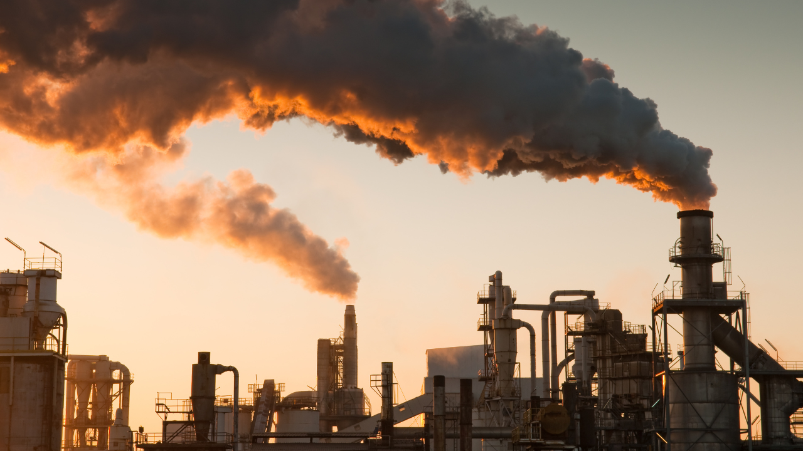
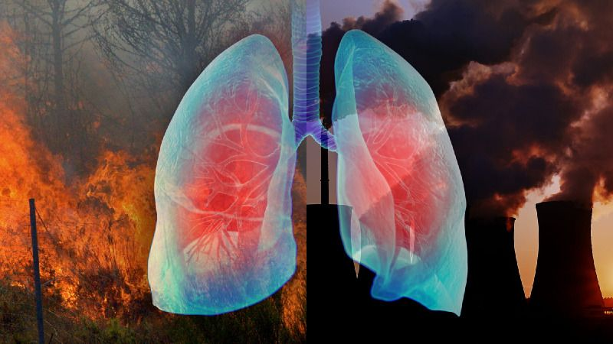
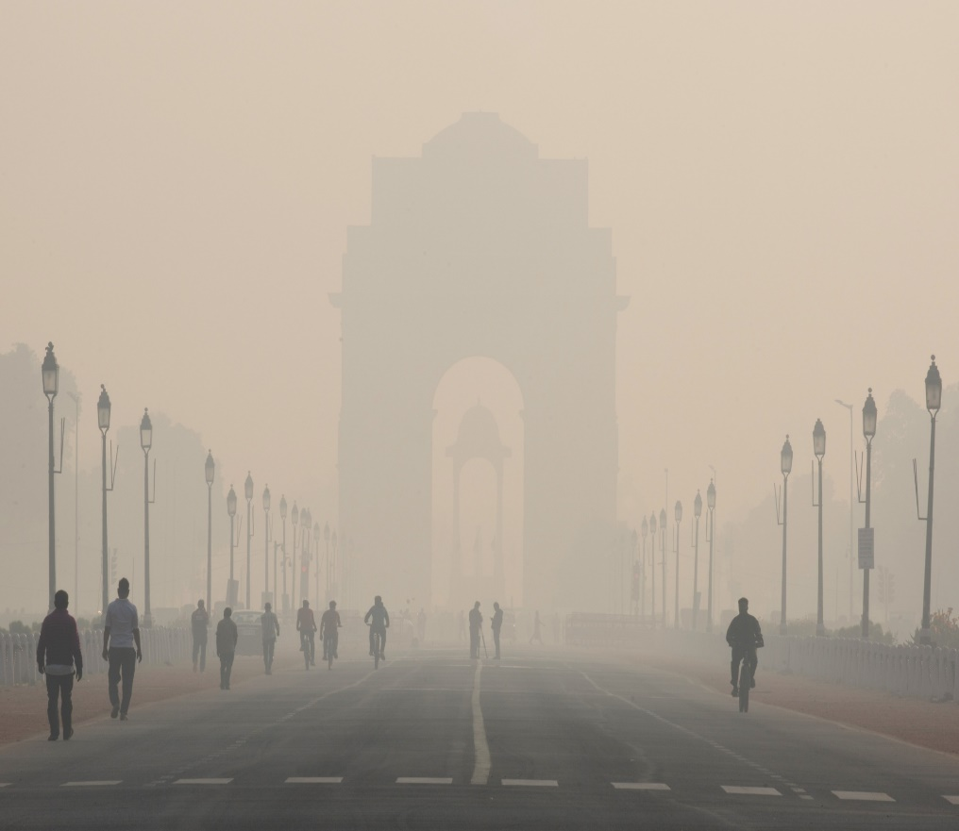
What is Air Pollution ?
Air pollution refers to the presence of harmful substances in the Earth's atmosphere that can cause adverse effects on living organisms, ecosystems, and the climate. These pollutants can originate from natural sources or human activities, leading to the deterioration of air quality.

Slide 4
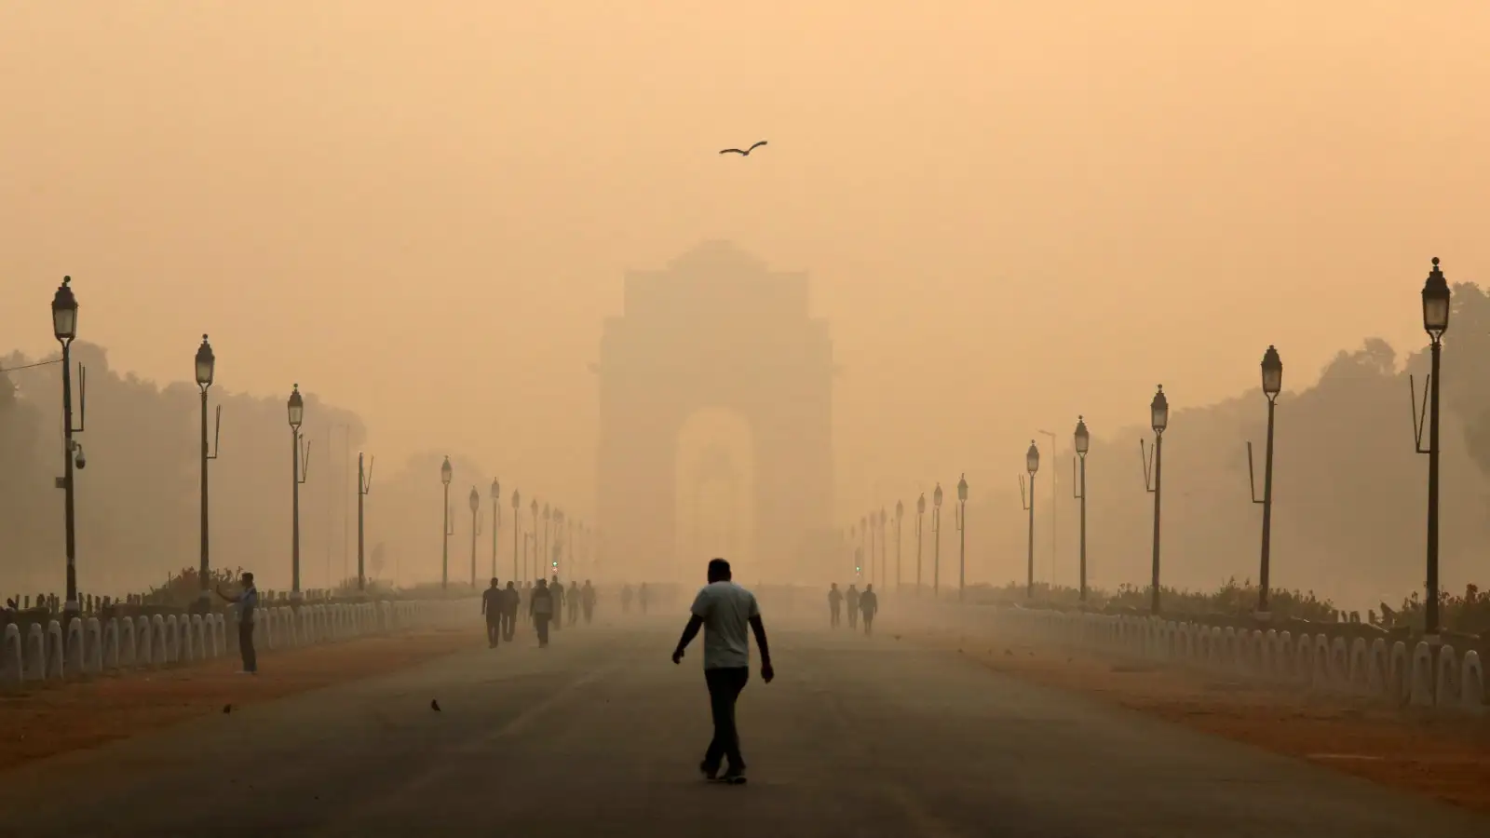

Identification of Air Pollution
Air Quality Index (AQI)
A numerical scale that quantifies the concentration of key pollutants in the air.
Common pollutants measured include particulate matter, ground-level ozone, sulfur dioxide, nitrogen dioxide, carbon monoxide and lead.
Visible Indicators
Hazy or smoggy conditions.
Discoloration of buildings or vegetation.
Unpleasant odors.
Health Symptoms
Increased respiratory issues.
Irritation of eyes, nose, and throat.
Exacerbation of pre-existing health conditions.

Slide 5
Causes of Air Pollution

Slide 6
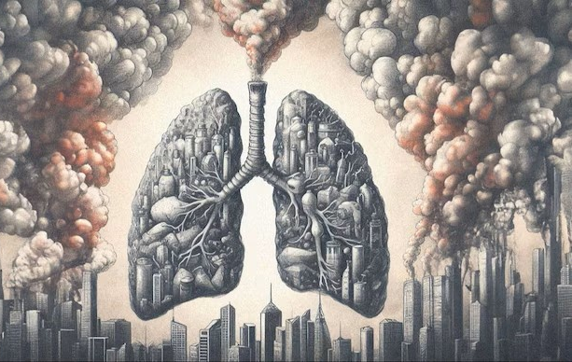
Causes of Air Pollution
Air pollution can have both natural and anthropogenic causes, including:
Combustion of Fossil Fuels
Emissions from vehicles, power plants, and industrial facilities burning coal, oil, and natural gas.
Industrial Activities
Release of pollutants during manufacturing processes.
Agricultural Practices
Use of fertilizers and pesticides.
Livestock emissions.
Biomass - burning
Waste Management
Improper disposal of solid waste and incineration.
Deforestation
Reduction in the number of
trees contributing to increased carbon dioxide levels.

Slide 7
Symptoms of Air Pollution

Slide 8




02.
04.
Nausea, dizziness, headache
Runny nose, sore throat, red eyes
01.
Coughing, Wheezing, aggravation of Asthma
03.
Aggravation of heart conditions, increased risk of heart attacks

Slide 9
What to do?

Slide 10
MEASURES TO BE TAKEN
Reducing Emissions: Implementing and enforcing stricter emission standards for vehicles and industrial facilities. Promoting the use of clean and renewable energy sources. Switching to cleaner fuels with lower sulfur content.
Urban Planning: Designing cities to reduce traffic congestion and promote public transportation. Encouraging the use of bicycles and walking.
Waste Management: Implementing proper waste disposal and recycling programs. Minimizing open burning of biomass waste and incineration.
Afforestation and Green Spaces: Planting trees and creating green spaces to absorb pollutants and improve air quality.
Public Awareness: Educating the public about the sources and health impacts of air pollution. Encouraging individual actions to reduce personal carbon footprints.

Slide 11
ASSESSMENT
Which of these health problems is NOT significantly worsened by air pollution?
  Asthma
  Heart disease
  Skin cancer
  Eye irritation
What simple action can you take every day to reduce air pollution in your community?
  Use more public transportation or bike more.
  Conserve energy by using less electricity and water.
  Choose products with less packaging.
  All of the above.
Answer: 1) c 2) d

Slide 12
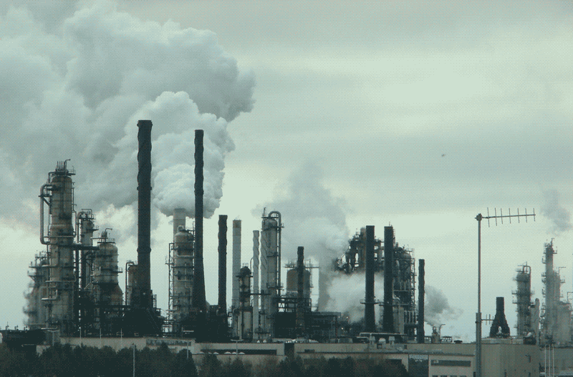
REFRESHER
Air pollution is the presence of harmful substances in the Earth's atmosphere, causing adverse effects on living organisms, ecosystems, and climate.
Common pollutants include particulate matter, ground-level ozone, sulfur dioxide, nitrogen dioxide, carbon monoxide, and lead. Visible indicators include hazy or smoggy conditions, discoloration of buildings or vegetation, and unpleasant odors.
Causes include fossil fuel combustion, industrial activities, agricultural practices, waste management, and deforestation.
Symptoms include coughing, wheezing, asthma aggravation, runny nose, sore throat, red eyes, heart conditions aggravation, nausea, dizziness, and headache.
Measures to reduce air pollution include stricter emission standards, urban planning, waste management, afforestation and green spaces, and public awareness about the sources and health impacts of air pollution.

Slide 13
Thank you for your attention, It may save a life one day
FOR MORE INFORMATION CONTACT +91 9911772407 OR EMAIL AT INFO@INFINITI8.ORG

