Slide 1
Medical Emergencies
DEFINITION, IDENTIFICATION, CAUSES, SYMPTOMS, AND TREATMENT GUIDE

Slide 2
1. Abdominal Pain

Slide 3
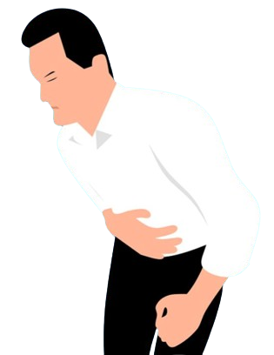
What is an Abdominal Pain?
Abdominal pain is discomfort or pain in the abdomen, caused by various factors such as digestive issues, infections, or organ-related problems. Seeking medical attention is important for severe or persistent cases.

Slide 4
How do you identify someone having abdominal pain?
Pain in the abdomen may be aching, stabbing, burning, twisting, cramping, dull, or gnawing

Slide 5
Symptoms and Causes of Abdominal Pain

Slide 6
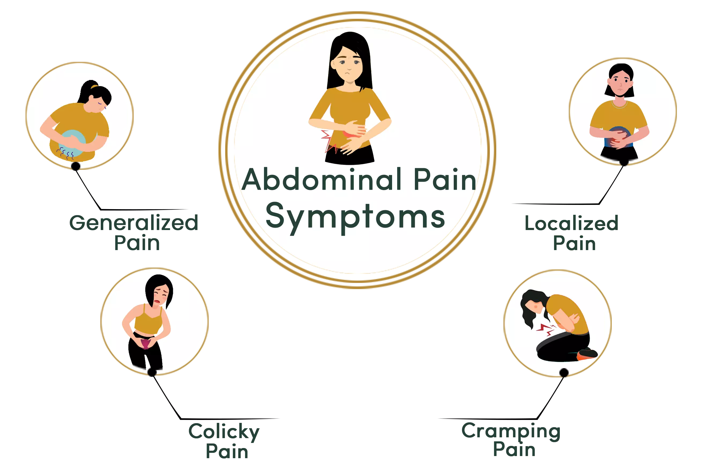
Symptoms:
Pain characteristics: sharp, crampy, dull, or intermittent.
Location: may be localized or radiate.
Associated symptoms: nausea, vomiting, bloating, diarrhea, constipation, fever.
Aggravating factors: specific activities, eating, or movement.
Relieving factors: rest, certain positions, or medications.

Slide 7
Causes of Abdominal Pain
Digestive issues: indigestion, gas, constipation, diarrhea.
Gastrointestinal conditions: gastritis, gastroenteritis, IBS, IBD, peptic ulcers.
Infections: appendicitis, urinary tract infections, pelvic inflammatory disease.
Organ-related problems: liver or gallbladder issues, kidney stones or infections, pancreatitis.
Gynecological issues: ovarian cysts, endometriosis, menstrual cramps.
Musculoskeletal issues: strained muscles or ligaments in the abdomen.
Referred pain: pain from other body parts felt in the abdomen.

Slide 8
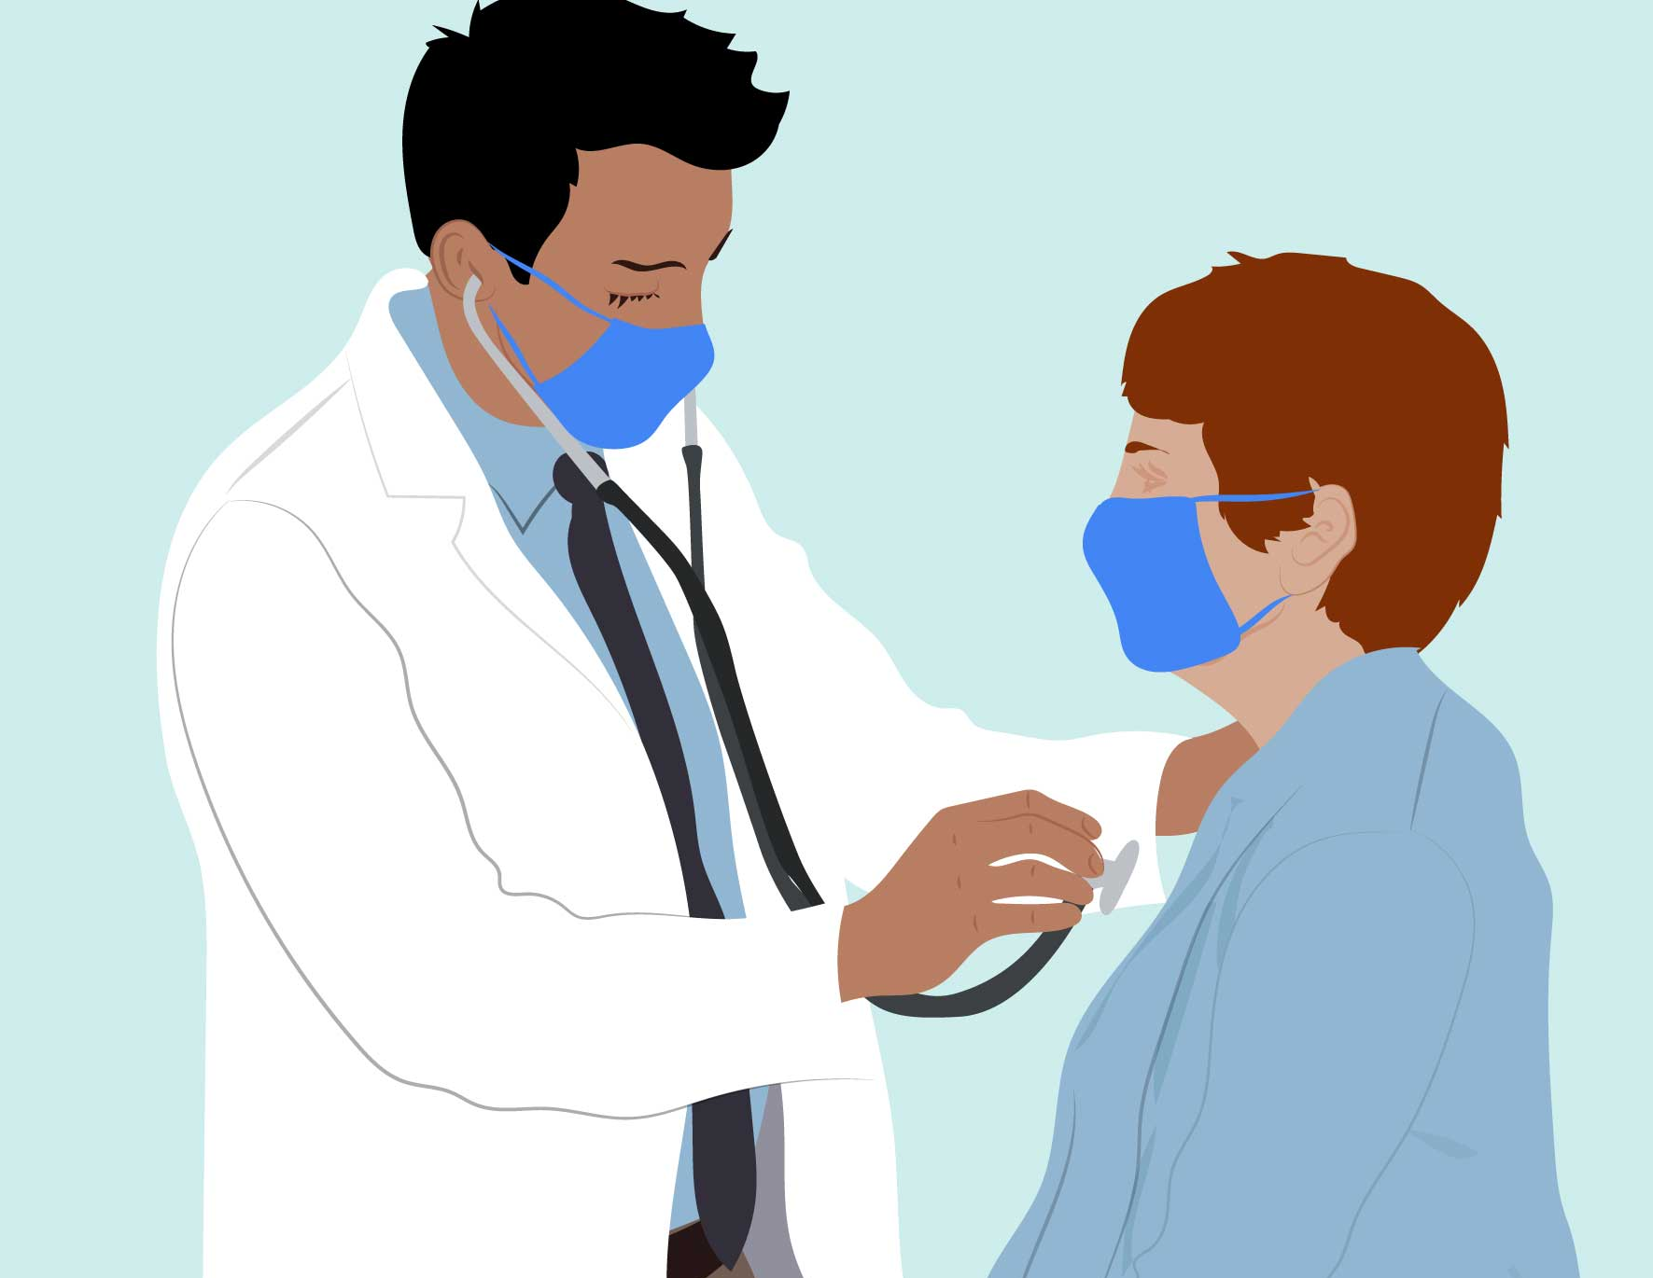
What to do?
1. Seek Medical Attention
2. Provide Details
3. Avoid Self-Diagnosis
1. Follow Medical Advices

Slide 9
Thank you for your attention, it may make a difference when it matters most FOR MORE INFORMATION CONTACT +91 9911772407 OR EMAIL AT INFO@INFINITI8.ORG

